Slide 1
Database Systems
prof., dr., Vladimir Dimitrov

Slide 2
Data Storage
We begin our study of implementation of database management systems. The first issues we must address involve how a DBMS deals with very large amounts of data efficiently. The study can be divided into two parts:
How does a computer system store and manage very large amounts of data?
What representations and data structures best support efficient manipulations of this data?
First we explain the devices used to store massive amounts of information, especially rotating disks. We introduce the "memory hierarchy.” and see how the efficiency of algorithms involving very large amounts of data depends on the pattern of data movement between main memory and secondary storage (typically disks) or even "tertiary storage" (robotic devices for storing and accessing large numbers of optical disks or tape cartridges). A particular algorithm — two-phase, multiway merge sort — is used as an important example of an algorithm that uses the memory hierarchy effectively.
We also consider a number of techniques for lowering the time it takes to read or write data from disk. Finally, we discuss methods for improving the reliability of disks. Problems addressed include intermittent read- or write-errors, and "disk crashes," where data becomes permanently unreadable.
Our discussion begins with a fanciful examination of what goes wrong if one does not use the special methods developed for DBMS implementation.

Slide 3
The "Megatron 2002" Database System
If you have used a DBMS, you might imagine that implementing such a system is not hard. You might have in mind an implementation such as the recent (fictitious) offering from Megatron Systems Inc.: the Megatron 2002 Database Management System. This system, which is available under UNIX and other operating systems, and which uses the relational approach, supports SQL.

Slide 4
Megatron 2002 Implementation Details
To begin, Megatron 2002 uses the UNIX file system to store its relations. For example, the relation Students (name, id, dept) would be stored in the file /usr/db/Students. The file Students has one line for each tuple. Values of components of a tuple are stored as character strings, separated by the special marker character #. For instance, the file /usr/db/Students might look like:
Smith#123#CS
Johnson#522#EE
The database schema is stored in a special file named /usr/db/schema. For each relation, the file schema has a line beginning with that relation name, in which attribute names alternate with types. The character # separates elements of these lines. For example, the schema file might contain lines such as
Students#name#STR#id#INT#dept#STR
Depts#name#STR#office#STR
Here the relation Students (name, id, dept) is described; the types of attributes name and dept are strings while id is an integer. Another relation with schema Depts(name, office) is shown as well.

Slide 5
Example of a session using the Megatron 2002 DBMS
We are running on a machine called dbhost, and we invoke the DBMS
by the UNIX-level command megatron2002.
dbhost> megatron2002
produces the response
WELCOME TO MEGATRON 2002!
We are now talking to the Megatron 2002 user interface, to which we can type SQL queries in response to the Megatron prompt (&). A # ends a query. Thus:
& SELECT * FROM Students #
produces as an answer the table
name | id | dept
------------------
Smith | 123| CS
Johnson| 522| EE

Slide 6
Example of a session using the Megatron 2002 DBMS
Megatron 2002 also allows us to execute a query and store the result in a new file, if we end the query with a vertical bar and the name of the file. For instance,
& SELECT * FROM Students WHERE id >= 500 I Highid #
creates a new file /usr/db/HighId in which only the line
Johnson#522#EE
appears.

Slide 7
How Megatron 2002 Executes Queries
Let us consider a common form of SQL query:
SELECT * FROM R WHERE <Condition>
Megatron 2002 will do the following:
Read the file schema to determine the attributes of relation R and their types.
Check that the <Condition> is semantically valid for R.
Display each of the attribute names as the header of a column, and draw a line.
Read the file named R, and for each line:
Check the condition, and
Display the line as a tuple, if the condition is true.
To execute
SELECT * FROM R WHERE <condition> I T
Megatron 2002 does the following:
Process query as before, but omit step (3), which generates column headers and a line separating the headers from the tuples.
Write the result to a new file /usr/db/T.
3. Add to the file /usr/db/schema an entry for T that looks just like the entry for R, except that relation name T replaces R. That is, the schema for T is the same as the schema for R.

Slide 8
Example
Now, let us consider a more complicated query, one involving a join of our two example relations Students and Depts:
SELECT office
FROM Students, Depts
WHERE Students.name = ‘Smith’ AND
Students.dept = Depts.name #
This query requires that Megatron 2002 join relations Students and Depts. That is, the system must consider in turn each pair of tuples, one from each relation, and determine whether:
The tuples represent the same department, and
The name of the student is Smith.
The algorithm can be described informally as:
FOR each tuple s in Students DO
FOR each tuple d in Depts DO
IF s and d satisfy the where-condition THEN
display the office value from Depts;

Slide 9
What’s Wrong With Megatron 2002?
It may come as no surprise that a DBMS is not implemented like our imaginary Megatron 2002. There are a number of ways that the implementation described here is inadequate for applications involving significant amounts of data or multiple users of data. A partial list of problems follows:
The tuple layout on disk is inadequate, with no flexibility when the database is modified. For instance, if we change EE to ECON in one Students tuple, the entire file has to be rewritten, as every subsequent character is moved two positions down the file.
Search is very expensive. We always have to read an entire relation, even if the query gives us a value or values that enable us to focus on one tuple, as in the query of the example. There, we had to look at the entire Student relation, even though the only one we wanted was that for student Smith.
Query-processing is by "brute force," and much cleverer ways of performing operations like joins are available. For instance, we shall see that in a query like that of example, it is not necessary to look at all pairs of tuples, one from each relation, even if the name of one student (Smith) were not specified in the query.
There is no way for useful data to be buffered in main memory; all data comes off the disk, all the time.
There is no concurrency control. Several users can modify a file at the same time, with unpredictable results.
There is no reliability; we can lose data in a crash or leave operations half done.

Slide 10
The Memory Hierarchy
A typical computer system has several different components in which data may be stored. These components have data capacities ranging over at least seven orders of magnitude and also have access speeds ranging over seven or more orders of magnitude. The cost per byte of these components also varies, but more slowly, with perhaps three orders of magnitude between the cheapest and most expensive forms of storage. Not surprisingly, the devices with smallest capacity also offer the fastest access speed and have the highest cost per byte.

Slide 11
DBMS
Programs, Main-memory DBMS’s
Tertiary Storage
Disk
As Virtual Memory
File System
Main Memory
Cache

Slide 12
Cache
At the lowest level of the hierarchy is a cache. On-board cache is found on the same chip as the microprocessor itself, and additional level-2 cache is found on another chip. The data items (including machine instructions) in the cache are copies of certain locations of main memory, the next higher level of the memory hierarchy. Sometimes, the values in the cache are changed, but the corresponding change to the main memory is delayed. Nevertheless, each value in the cache at any one time corresponds to one place in main memory. The unit of transfer between cache and main memory is typically a small number of bytes. We may therefore think of the cache as holding individual machine instructions, integers, floating-point numbers or short character strings.
When the machine executes instructions, it looks both for the instructions and for the data used by those instructions in the cache. If it doesn't find them there, it goes to main-memory and copies the instructions or data into the cache. Since the cache can hold only a limited amount of data, it is usually necessary to move something out of the cache in order to accommodate the new data. If what is moved out of cache has not changed since it was copied to cache, then nothing needs to be done. However, if the data being expelled from the cache has been modified, then the new value must be copied into its proper location in main memory.

Slide 13
Cache
When data in the cache is modified, a simple computer with a single processor has no need to update immediately the corresponding location in main memory. However, in a multiprocessor system that allows several processors to access the same main memory and keep their own private caches, it is often necessary for cache updates to write through, that is, to change the corresponding place in main memory immediately.
Typical caches in 2001 have capacities up to a megabyte. Data can be read or written between the cache and processor at the speed of the processor instructions, commonly a few nanoseconds (a nanosecond is 10⁻⁹ seconds). On the other hand, moving an instruction or data item between cache and main memory takes much longer, perhaps 100 nanoseconds.

Slide 14
Main Memory
In the center of the action is the computer's main memory. We may think of everything that happens in the computer — instruction executions and data manipulations — as working on information that is resident in main memory (although in practice, it is normal for what is used to migrate to the cache).
In 2001, typical machines are configured with around 100 megabytes (10⁸ bytes) of main memory. However, machines with much larger main memories, 10 gigabytes or more (10¹⁰ bytes) can be found.
Main memories are random access, meaning that one can obtain any byte in the same amount of time. Typical times to access data from main memories are in the 10⁻¹⁰⁰ nanosecond range (10⁻⁸ to 10⁻⁷ seconds).
Although some modern parallel computers have a main memory shared by many processors in a way that makes the access time of certain parts of memory different, by perhaps a factor of 3, for different processors.

Slide 15
Computer Quantities are Powers of 2
It is conventional to talk of sizes or capacities of computer components as if they were powers of 10: megabytes, gigabytes, and so on. In reality, since it is most efficient to design components such as memory chips to hold a number of bits that is a power of 2, all these numbers are really short hands for nearby powers of 2. Since 2¹⁰ = 1024 is very close to a thousand, we often maintain the fiction that 2¹⁰ = 1000, and talk about 2¹⁰ with the prefix "kilo," 2²⁰ as "mega," 2³⁰ as "giga," 2⁴⁰ as "tera," and 2⁵⁰ as "peta," even though these prefixes in scientific parlance refer to 10³, 10⁶, 10⁹, 10¹² and 10¹⁵, respectively. The discrepancy grows as we talk of larger numbers. A "gigabyte" is really 1.074 x 10⁹ bytes.
We use the standard abbreviations for these numbers: K, M, G, T, and P for kilo, mega, giga, tera, and peta, respectively. Thus, 16Gb is sixteen gigabytes, or strictly speaking 2³⁴ bytes. Since we sometimes want to talk about numbers that are the conventional powers of 10, we shall reserve for these the traditional numbers, without the prefixes "kilo," "mega," and so on. For example, "one million bytes" is 1,000,000 bytes, while "one megabyte" is 1,048,576 bytes.

Slide 16
Virtual Memory
When we write programs, the data we use — variables of the program, files read, and so on — occupies a virtual memory address space. Instructions of the program likewise occupy an address space of their own. Many machines use a 32-bit address space; that is, there are 2³², or about 4 billion, different addresses. Since each byte needs its own address, we can think of a typical virtual memory as 4 gigabytes.
Since a virtual memory space is much bigger than the usual main memory, most of the content of a fully occupied virtual memory is actually stored on the disk. We discuss the typical operation of a disk later, but for the moment we need only to be aware that the disk is divided logically into blocks. The block size on common disks is in the range 4K to 56K bytes, i.e., 4 to 56 kilobytes. Virtual memory is moved between disk and main memory in entire blocks, which are usually called pages in main memory. The machine hardware and the operating system allow pages of virtual memory to be brought into any part of the main memory and to have each byte of that block referred to properly by its virtual memory address.

Slide 17
Virtual Memory
The path in previous figure involving virtual memory represents the treatment of conventional programs and applications. It does not represent the typical way data in a database is managed. However, there is increasing interest in main-memory database systems, which do indeed manage their data through virtual memory, relying on the operating system to bring needed data into main memory through the paging mechanism. Main-memory database systems, like most applications, are most useful when the data is small enough to remain in main memory without being swapped out by the operating system. If a machine has a 32-bit address space, then main-memory database systems are appropriate for applications that need to keep no more than 4 gigabytes of data in memory at once (or less if the machine's actual main memory is smaller than 2³² bytes). That amount of space is sufficient for many applications, but not for large, ambitious applications of DBMS's.
Thus, large-scale database systems will manage their data directly on the disk. These systems are limited in size only by the amount of data that can be stored on all the disks and other storage devices available to the computer system. We shall introduce this mode of operation next.

Slide 18
Moore’s Law
Gordon Moore observed many years ago that integrated circuits were improving in many ways, following an exponential curve that doubles about every 18 months. Some of these parameters that follow "Moore's law" are:
The speed of processors, i.e., the number of instructions executed per second and the ratio of the speed to cost of a processor.
The cost of main memory per bit and the number of bits that can be put on one chip.
The cost of disk per bit and the capacity of the largest disks.
On the other hand, there are some other important parameters that do not follow Moore's law; they grow slowly if at all. Among these slowly growing parameters are the speed of accessing data in main memory, or the speed at which disks rotate. Because they grow slowly, "latency" becomes progressively larger. That is, the time to move data between levels of the memory hierarchy appears to take progressively longer compared with the time to compute. Thus, in future years, we expect that main memory will appear much further away from the processor than cache, and data on disk will appear even further away from the processor. Indeed, these effects of apparent "distance" are already quite severe in 2001.

Slide 19
Secondary Storage
Essentially every computer has some sort of secondary storage, which is a form of storage that is both significantly slower and significantly more capacious than main memory, yet is essentially random-access, with relatively small differences among the times required to access different data items (these differences are discussed later). Modern computer systems use some form of disk as secondary memory. Usually this disk is magnetic, although sometimes optical or magneto-optical disks are used. The latter types are cheaper, but may not support writing of data on the disk easily or at all; thus they tend to be used only for archival data that doesn't change.
We observe from previous figure that the disk is considered the support for both virtual memory and a file system. That is, while some disk blocks will be used to hold pages of an application program's virtual memory, other disk blocks are used to hold (parts of) files. Files are moved between disk and main memory in blocks, under the control of the operating system or the database system.
Moving a block from disk to main memory is a disk read', moving the block from main memory to the disk is a disk write. We shall refer to either as a disk I/O. Certain parts of main memory are used to buffer files, that is, to hold block-sized pieces of these files.
For example, when you open a file for reading, the operating system might reserve a 4K block of main memory as a buffer for this file, assuming disk blocks are 4K bytes. Initially, the first block of the file is copied into the buffer. When the application program has consumed those 4K bytes of the file, the next block of the file is brought into the buffer, replacing the old contents. This process, illustrated in next figure, continues until either the entire file is read or the file is closed.

Slide 20
A file and its main-memory buffer
file
buffer

Slide 21
Secondary Storage
A DBMS will manage disk blocks itself, rather than relying on the operating system's file manager to move blocks between main and secondary memory. However, the issues in management are essentially the same whether we are looking at a file system or a DBMS. It takes roughly 10⁻³⁰ milliseconds (.01 to .03 seconds) to read or write a block on disk. In that time, a typical machine can execute several million instructions. As a result, it is common for the time to read or write a disk block to dominate the time it takes to do whatever must be done with the contents of the block. Therefore it is vital that, whenever possible, a disk block containing data we need to access should already be in a main-memory buffer. Then, we do not have to pay the cost of a disk I/O. We shall return to this problem later, where we see some examples of how to deal with the high cost of moving data between levels in the memory hierarchy.
In 2001, single disk units may have capacities of 100 gigabytes or more. Moreover, machines can use several disk units, so hundreds of gigabytes of secondary storage for a single machine is realistic. Thus, secondary memory is on the order of 10⁵ times slower but at least 100 times more capacious than typical main memory. Secondary memory is also significantly cheaper than main memory. In 2001, prices for magnetic disk units are 1 to 2 cents per megabyte, while the cost of main memory is 1 to 2 dollars per megabyte.

Slide 22
Tertiary Storage
As capacious as a collection of disk units can be, there are databases much larger than what can be stored on the disk(s) of a single machine, or even of a substantial collection of machines. For example, retail chains accumulate many terabytes of data about their sales, while satellites return petabytes of information per year.
To serve such needs, tertiary storage devices have been developed to hold data volumes measured in terabytes. Tertiary storage is characterized by significantly higher read/write times than secondary storage, but also by much larger capacities and smaller cost per byte than is available from magnetic disks. While main memory offers uniform access time for any datum, and disk offers an access time that does not differ by more than a small factor for accessing any datum, tertiary storage devices generally offer access times that vary widely, depending on how close to a read/write point the datum is.

Slide 23
Tertiary Storage
Ad-hoc Tape Storage. The simplest — and in past years the only — approach to tertiary storage is to put data on tape reels or cassettes and to store the cassettes in racks. When some information from the tertiary store is wanted, a human operator locates and mounts the tape on a reader. The information is located by winding the tape to the correct position, and the information is copied from tape to secondary storage or to main memory. To write into tertiary storage, the correct tape and point on the tape is located, and the copy proceeds from disk to tape.
Optical-Disk Juke Boxes. A "juke box" consists of racks of CD-ROM's (CD = "compact disk"; ROM = "read-only memory." These are optical disks of the type used commonly to distribute software). Bits on an optical disk are represented by small areas of black or white, so bits can be read by shining a laser on the spot and seeing whether the light is reflected. A robotic arm that is part of the jukebox extracts any one CD-ROM and move it to a reader. The CD can then have its contents, or part thereof, read into secondary memory.
Tape Silos. A "silo" is a room-sized device that holds racks of tapes. The tapes are accessed by robotic arms that can bring them to one of several tape readers. The silo is thus an automated version of the earlier ad-hoc storage of tapes. Since it uses computer control of inventory and automates the tape-retrieval process, it is at least an order of magnitude faster than human-powered systems.

Slide 24
Tertiary Storage
The capacity of a tape cassette in 2001 is as high as 50 gigabytes. Tape silos can therefore hold many terabytes. CD's have a standard of about 2/3 of a gigabyte, with the next-generation standard of about 2.5 gigabytes (DVD's or digital versatile disks) becoming prevalent. CD-ROM jukeboxes in the multiterabyte range are also available.
The time taken to access data from a tertiary storage device ranges from a few seconds to a few minutes. A robotic arm in a jukebox or silo can find the desired CD-ROM or cassette in several seconds, while human operators probably require minutes to locate and retrieve tapes. Once loaded in the reader, any part of the CD can be accessed in a fraction of a second, while it can take many additional seconds to move the correct portion of a tape under the read-head of the tape reader.
In summary, tertiary storage access can be about 1000 times slower than secondary-memory access (milliseconds versus seconds). However, single tertiary-storage units can be 1000 times more capacious than secondary storage devices (gigabytes versus terabytes). Next figure shows, on a log-log scale, the relationship between access times and capacities for the four levels of memory hierarchy that we have studied. We include "Zip" and "floppy" disks ("diskettes"), which are common storage devices, although not typical of secondary storage used for database systems. The horizontal axis measures seconds in exponents of 10; e.g., -3 means 10⁻³ seconds, or one millisecond. The vertical axis measures bytes, also in exponents of 10; e.g., 8 means 100 megabytes.

Slide 25
Access time versus capacity for various levels of the memory hierarchy
Tertiary
Secondary
Main
Zip disk
Floppy disk
Cache

Slide 26
Volatile and Nonvolatile Storage
An additional distinction among storage devices is whether they are volatile or nonvolatile. A volatile device "forgets" what is stored in it when the power goes off. A nonvolatile device, on the other hand, is expected to keep its contents intact even for long periods when the device is turned off or there is a power failure. The question of volatility is important, because one of the characteristic capabilities of a DBMS is the ability to retain its data even in the presence of errors such as power failures.
Magnetic materials will hold their magnetism in the absence of power, so devices such as magnetic disks and tapes are nonvolatile. Likewise, optical devices such as CD's hold the black or white dots with which they are imprinted, even in the absence of power. Indeed, for many of these devices it is impossible to change what is written on their surface by any means. Thus, essentially all secondary and tertiary storage devices are nonvolatile.
On the other hand, main memory is generally volatile. It happens that a memory chip can be designed with simpler circuits if the value of the bit is allowed to degrade over the course of a minute or so; the simplicity lowers the cost per bit of the chip. What actually happens is that the electric charge that represents a bit drains slowly out of the region devoted to that bit. As a result, a so-called dynamic random-access memory, or DRAM, chip needs to have its entire contents read and rewritten periodically. If the power is off, then this refresh does not occur, and the chip will quickly lose what is stored.

Slide 27
Volatile and Nonvolatile Storage
A database system that runs on a machine with volatile main memory must back up every change on disk before the change can be considered part of the database, or else we risk losing information in a power failure. As a consequence, query and database modifications must involve a large number of disk writes, some of which could be avoided if we didn't have the obligation to preserve all information at all times. An alternative is to use a form of main memory that is not volatile. New types of memory chips, called flash memory, are nonvolatile and are becoming economical. An alternative is to build a so-called RAM disk from conventional memory chips by providing a battery backup to the main power supply.

Slide 28
Disks
The use of secondary storage is one of the important characteristics of a DBMS, and secondary storage is almost exclusively based on magnetic disks. Thus, to motivate many of the ideas used in DBMS implementation, we must examine the operation of disks in detail.

Slide 29
Mechanics of Disks
The two principal moving pieces of a disk drive are shown in next figure; they are a disk assembly and a head assembly. The disk assembly consists of one or more circular platters that rotate around a central spindle. The upper and lower surfaces of the platters are covered with a thin layer of magnetic material, on which bits are stored. A 0 is represented by orienting the magnetism of a small area in one direction and a 1 by orienting the magnetism in the opposite direction. A common diameter for disk platters is 3.5 inches, although disks with diameters from an inch to several feet have been built.

Slide 30
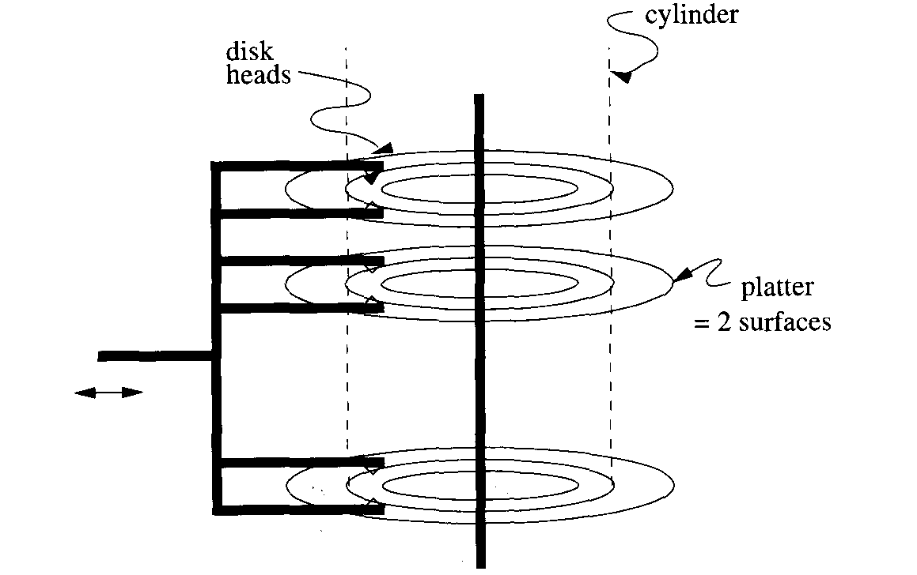
A typical disk

Slide 31
Disks
The locations where bits are stored are organized into tracks, which are concentric circles on a single platter. Tracks occupy most of a surface, except for the region closest to the spindle, as can be seen in the top view of next figure. A track consists of many points, each of which represents a single bit by the direction of its magnetism.

Slide 32
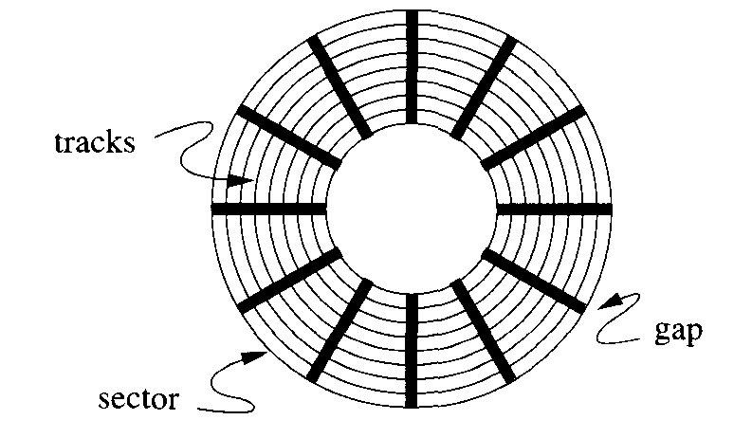
Top view of a disk surface

Slide 33
Disks
Tracks are organized into sectors, which are segments of the circle separated by gaps that are not magnetized in either direction. (We show each track with the same number of sectors. However, as we shall discuss, the number of sectors per track may vary, with the outer tracks having more sectors than inner tracks.) The sector is an indivisible unit, as far as reading and writing the disk is concerned. It is also indivisible as far as errors are concerned. Should a portion of the magnetic layer be corrupted in some way, so that it cannot store information, then the entire sector containing this portion cannot be used. Gaps often represent about 10% of the total track and are used to help identify the beginnings of sectors. As we mentioned, blocks are logical units of data that are transferred between disk and main memory; blocks consist of one or more sectors.

Slide 34
Disks
The second movable piece shown in the figure, the head assembly, holds the disk heads. For each surface there is one head, riding extremely close to the surface but never touching it (or else a “head crash” occurs and the disk is destroyed, along with everything stored thereon). A head reads the magnetism passing under it, and can also alter the magnetism to write information on the disk. The heads are each attached to an arm, and the arms for all the surfaces move in and out together, being part of the rigid head assembly.

Slide 35
The Disk Controller
One or more disk drives are controlled by a disk controller, which is a small processor capable of:
Controlling the mechanical actuator that moves the head assembly, to position the heads at a particular radius. At this radius, one track from each surface will be under the head for that surface and will therefore be readable and writable. The tracks that are under the heads at the same time are said to form a cylinder.
Selecting a surface from which to read or write, and selecting a sector from the track on that surface that is under the head. The controller is also responsible for knowing when the rotating spindle has reached the point where the desired sector is beginning to move under the head.
Transferring the bits read from the desired sector to the computer’s main memory or transferring the bits to be written from main memory to the intended sector.
The next figure shows a simple, single-processor computer. The processor communicates via a data bus with the main memory and the disk controller. A disk controller can control several disks; we show three disks in this computer.

Slide 36
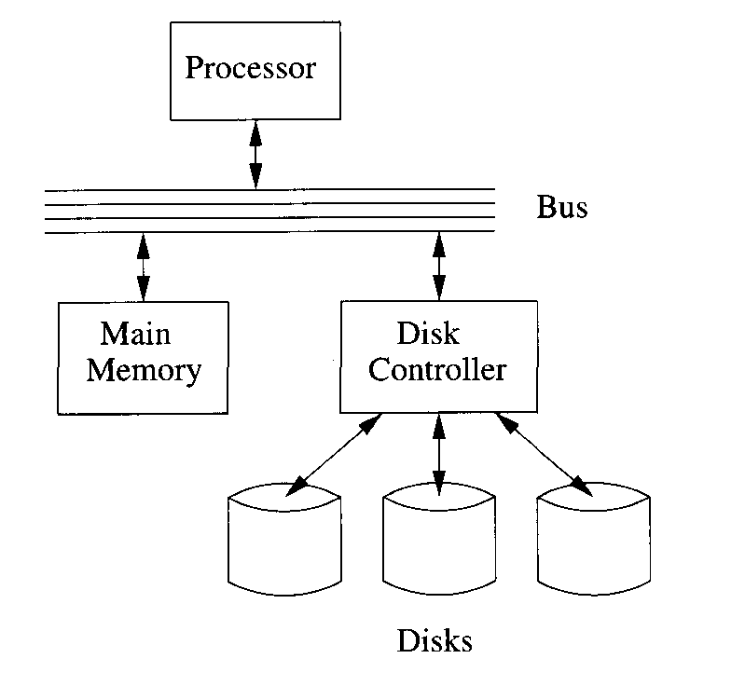
Schematic of a simple computer system

Slide 37
Disk Storage Characteristics
Disk technology is in flux, as the space needed to store a bit shrinks rapidly. In 2001, some of the typical measures associated with disks are:
Rotation Speed of the Disk Assembly. 5400 RPM, i.e., one rotation every 11 milliseconds, is common, although higher and lower speeds are found.
Number of Platters per Unit. A typical disk drive has about five platters and therefore ten surfaces. However, the common diskette (“floppy” disk) and “Zip” disk have a single platter with two surfaces, and disk drives with up to 30 surfaces are found.
Number of Tracks per Surface. A surface may have as many as 20,000 tracks, although diskettes have a much smaller number.
Number of Bytes per Track. Common disk drives may have almost a million bytes per track, although diskettes’ tracks hold much less. As mentioned, tracks are divided into sectors. Figure shows 12 sectors per track, but in fact as many as 500 sectors per track are found in modern disks. Sectors, in turn, may hold several thousand bytes.

Slide 38
Sectors Versus Blocks
Remember that a “sector” is a physical unit of the disk, while a “block” is a logical unit, a creation of whatever software system operating system or DBMS, for example is using the disk. As we mentioned, it is typical today for blocks to be at least as large as sectors and to consist of one or more sectors. However, there is no reason why a block cannot he a fraction of a sector, with several blocks packed into one sector. In fact, some older systems did use this strategy.

Slide 39
Example
The Megatron 77 disk has the following characteristics, which are typical of a large, vintage-2001 disk drive,
There are eight platters providing sixteen surfaces.
There are 214, or 16,384 tracks per surface.
There are (on average) 2 128 sectors per track.
There are 212 4096 bytes per sector.
The capacity of the disk is the product of 16 surfaces, times 16,384 tracks, times 128 sectors, times 1096 bytes, or bytes. The Megatron 747 is thus a 128-gigabyte disk A single track holds 128 x 4096 bytes, or 512K bytes. If blocks are 214, or 16,384 bytes, then one block uses 4 consecutive sectors, and there are 128/4 = 32 blocks on a track.
The Megatron 747 has surfaces of 3.5-inch diameter. The tracks occupy the outer inch of the surfaces, and the inner 0.75 inch is unoccupied. The density of hits in the radial direction is this 16,384 per inch, because that is the number of tracks.
The density of bits around the tracks is far greater. Let us suppose at first that each track has the average number of sectors, 128. Suppose that the gaps occupy 10% of the tracks, so the 512K bytes per track (or 4M bits) occupy 90% of the track. The length of the outermost track is 3.5π or about 11 inches. Ninety percent of this distance, or about 9.9 inches, holds 4 megabits. Hence the density of hits in the occupied portion of the track is about 420,000 bits per inch.
On the other hand, the innermost track has a diameter of only 1.5 inches and would store the same 4 megabits in 0.9 x 1.5 x π or about 4.2 inches. The bit density of the inner tracks is thus around one megabit per inch.
Since the densities of inner and outer tracks would vary too much if the number of sectors and bits were kept uniform, the Megatron 747, like other modern disks, stores more sectors on the outer tracks than on inner tracks. For example, we could store 128 sectors per track on the middle third, but only 96 sectors on the inner third and 160 sectors on the outer third of the tracks. If we did, then the density would range from 530,000 bits to 742,000 bits per inch, at the outermost and innermost tracks, respectively..

Slide 40
Example
At the small end of the range of disks is the standard 3.5-inch diskette. It has two surfaces with 40 tracks each, for a total of 80 tracks. The capacity of this disk, formatted in either the MAC or PC formats, is about 1.5 megabytes of data, or 150,000 bits (18,750 bytes) per track. About one quarter of the available space is taken up by gaps and other disk overhead in either format.

Slide 41
Disk Access Characteristics
Our study of DBMS’s requires us to understand not only the way data is stored on disks but the way it is manipulated. Since all computation takes place in main memory or cache, the only issue as far as the disk is concerned is how to move blocks of data between disk and main memory. As we mentioned, blocks (or the consecutive sectors that comprise the blocks) are read or written when:
The heads are positioned at the cylinder containing the track on which the block is located, and
The sectors containing the block move under the disk head as the entire disk assembly rotates.

Slide 42
Disk Access Characteristics
The time taken between the moment at which the command to read a block is issued and the time that the contents of the block appear in main memory is called the latency of the disk. It can be broken into the following components:
The time taken by the processor and disk controller to process the request, usually a fraction of a millisecond, which we shall neglect. We shall also neglect time due to contention for the disk controller (some other process might be reading or writing the disk at the same time) and other delays due to contention, such as for the bus.
Seek time: the time to position the head assembly at the proper cylinder. Seek time can be 0 if the heads happen already to be at the proper cylinder. If not, then the heads require some minimum time to start moving and to stop again, plus additional time that is roughly proportional to the distance traveled. Typical minimum times, the time to start, move by one track, and stop, are a few milliseconds, while maximum times to travel across all tracks are in the 10 to 40 millisecond range. The next figure suggests how seek time varies with distance. It shows seek time beginning at some value x for a distance of one cylinder and suggests that the maximum seek time is in the range 3x to 20x. The average seek time is often used as a way to characterize the speed of the disk.

Slide 43
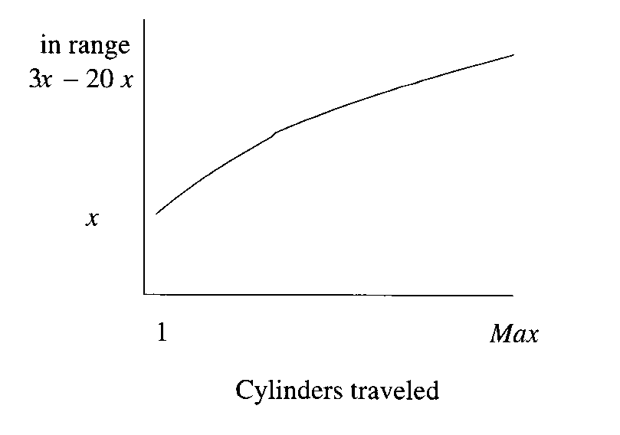
Seek time varies with distance traveled

Slide 44
Disk Access Characteristics
Rotational latency: the time for the disk to rotate so the first of the sectors containing the block reaches the head. A typical disk rotates completely about once every 10 milliseconds. On the average, the desired sector will be about half way around the circle when the heads arrive at its cylinder, so the average rotational latency is around 5 milliseconds. The next figure illustrates the problem of rotational latency.

Slide 45
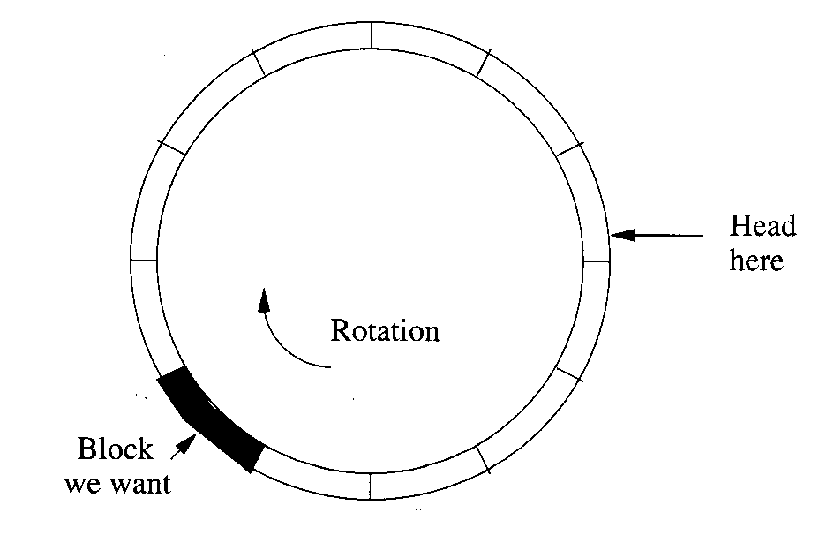
Disk Access Characteristics

Slide 46
Disk Access Characteristics
Transfer time: the time it takes the sectors of the block and any gaps between them to rotate past the head. If a disk has 250,000 bytes per track and rotates once in 10 milliseconds, we can read from the disk at 25 megabytes per second. The transfer time for a 16,384-byte block is around two-thirds of a millisecond

Slide 47
Example
Let us examine the time it takes to read a 16,384-byte block from the Megatron 747 disk. First, we need to know some timing properties of the disk:
The disk rotates at 7200 rpm; i.e., it makes one rotation in 8.33 milliseconds.
To move the head assembly between cylinders takes one millisecond to start and stop, plus one additional millisecond for every 1000 cylinders traveled. Thus, the heads move one track in 1.001 milliseconds and move from the innermost to the outermost track, a distance of 16,383 tracks, in about 17.38 milliseconds.
Let us calculate the minimum, maximum, and average times to read that 16,384-byte block. The minimum time, since we are neglecting overhead and contention due to use of the controller, is just the transfer time. That is, the block might be on a track over which the head is positioned already, and the first sector of the block might be about to pass under the head.

Slide 48
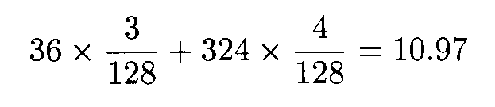
Example
Since there are 4096 bytes per sector on the Megatron 747, the block occupies four sectors. The heads must therefore pass over four sectors and the three gaps between them. Recall that the gaps represent 10% of the circle and sectors the remaining 90%. There are 128 gaps and 128 sectors around the circle. Since the gaps together cover 36 degrees of arc and sectors the remaining 324 degrees, the total degrees of arc covered by 3 gaps and 4 sectors is:
degrees.

Slide 49
Example
The transfer time is thus (10.97/360) x 0.00833 = .000253 seconds, or about a quarter of a millisecond. That is, 10.97/360 is the fraction of a rotation needed to read the entire block, and .00833 seconds is the amount of time for a 360-degree rotation.
Now, let us look at the maximum possible time to read the block. In the worst case, the heads are positioned at the innermost cylinder, and the block we want to read is on the outermost cylinder (or vice versa). Thus, the first thing the controller must do is move the heads. As we observed above, the time it takes to move the Megatron 747 heads across all cylinders is about 17.38 milliseconds. This quantity is the seek time for the read.
The worst thing that can happen when the heads arrive at the correct cylinder is that the beginning of the desired block has just passed under the head. Assuming we must read the block starting at the beginning, we have to wait essentially a full rotation, or 8.33 milliseconds for the beginning of the block to reach the head again. Once that happens, we have only to wait an amount equal to the transfer time, 0.25 milliseconds, to read the entire block. Thus, the worst-case latency is 17.38 + 8.33 + 0.25 = 25.96 milliseconds.

Slide 50
Example
Last let us compute the average time to read a block. Two of the components of the latency are easy to compute: the transfer time is always 0.25 milliseconds, and the average rotational latency is the time to rotate the disk half way around, or 4.17 milliseconds. We might suppose that the average seek time is just the time to move across half the tracks. However, that is not quite right, since typically, the heads are initially somewhere near the middle and therefore will have to move less than half the distance, on average, to the desired cylinder.
A more detailed estimate of the average number of tracks the head must move is obtained as follows. Assume the heads are initially at any of the 16,384 cylinders with equal probability. If at cylinder 1 or cylinder 16,384, then the average number of tracks to move is (1 + 2 + . . . + 16383)716384, or about 8192 tracks. At the middle cylinder 8192, the head is equally likely to move in or out, and either way, it will move on average about a quarter of the tracks, or 4096 tracks. A bit of calculation shows that as the initial head position varies from cylinder 1 to cylinder 8192, the average distance the head needs to move decreases quadratically from 8192 to 4096. Likewise, as the initial position varies from 8192 up to 16,384, the average distance to travel increases quadratically back up to 8192, as suggested in figure.
If we integrate the quantity in next figure over all initial positions, we find that the average distance traveled is one third of the way across the disk, or 5461 cylinders. That is, the average seek time will be one millisecond, plus the time to travel 5461 cylinders, or 1 + 5461/1000 6.46 milliseconds. (Note that this calculation ignores the possibility that we do not have to move the head at all, but that case occurs only once in 16,384 times assuming random block requests. On the other hand, random block requests is not necessarily a good assumption, as we shall see later. ) Our estimate of the average latency is thus 6.46 + 4.17 + 0.25 = 10.88 milliseconds; the three terms represent average seek time, average rotational latency, and transfer time, respectively.

Slide 51
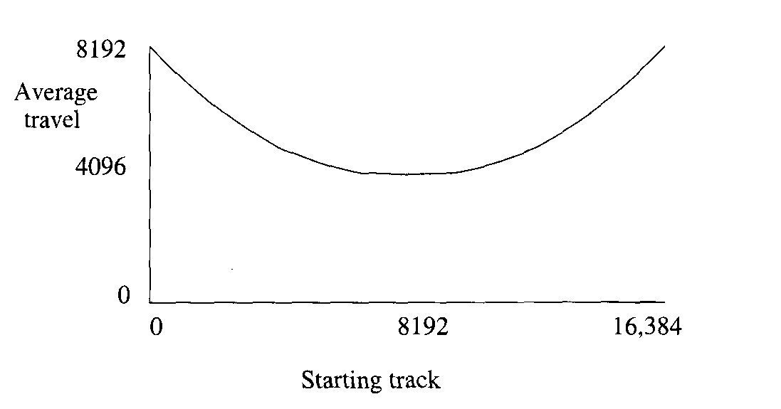
Average travel distance as a function of initial head position

Slide 52
Trends in Disk-Controller Architecture
As the cost of digital hardware drops precipitously, disk controllers are beginning to look more like computers of their own, with general-purpose processors and substantial random-access memory. Among the many things that might be done with such additional hardware, disk controllers are beginning to read and store in their local memory entire tracks of a disk, even if only one block from that track is requested. This capability greatly reduces the average access time for blocks, as long as we need all or most of the blocks on a single track. Later we will discuss some of the applications of full-track or full-cylinder reads and writes.

Slide 53
Writing Blocks
The process of writing a block is, in its simplest form, quite analogous to reading a block. The disk heads are positioned at the proper cylinder, and we wait for the proper sector(s) to rotate under the head. But, instead of reading the data under the head we use the head to write new data. The minimum, maximum and average times to write would thus be exactly the same as for reading.
A complication occurs if we want to verify that the block was written correctly. If so, then we have to wait for an additional rotation and read each sector back to check that what was intended to be written is actually stored there. A simple way to verify correct writing by using checksums is discussed in later.

Slide 54
Modifying Blocks
It is not possible to modify a block on disk directly. Rather, even if we wish to modify only a few bytes (e.g., a component of one of the tuples stored in the block), we must do the following:
Read the block into main memory.
Make whatever changes to the block are desired in the main-memory copy of the block.
Write the new contents of the block back onto the disk.
If appropriate, verify that the write was done correctly.
The total time for this block modification is thus the sum of time it takes to read, the time to perform the update in main memory (which is usually negligible compared to the time to read or write to disk), the time to write, and, if verification is performed, another rotation time of the disk.
We might wonder whether the time to write the block we just read is the same as the time to perform a “random” write of a block. If the heads stay where they are, then we know we have to wait a full rotation to write, hut the seek time is zero. However, since the disk controller does not know when the application will finish writing the new value of the block, the heads may well have moved to another track to perform some other disk I/O before the request to write the new value of the block is made.

Slide 55
Using Secondary Storage Effectively
In most studies of algorithms, one assumes that the data is in main memory, and access to any item of data takes as much time as any other. This model of computation is often called the “RAM model” or random-access model of computation. However, when implementing a DBMS, one must assume that the data does not fit into main memory. One must therefore take into account the use of secondary, and perhaps even tertiary storage in designing efficient algorithms. The best algorithms for processing very large amounts of data thus often differ from the best main-memory algorithms for the same problem.
We shall consider primarily the interaction between main and secondary memory. In particular, there is a great advantage in choosing an algorithm that uses few disk accesses, even if the algorithm is not very efficient when viewed as a main-memory algorithm. A similar principle applies at each level of the memory hierarchy. Even a main-memory algorithm can sometimes be improved if we remember the size of the cache and design our algorithm so that data moved to cache tends to be used many times. Likewise, an algorithm using tertiary storage needs to take into account the volume of data moved between tertiary and secondary memory, and it is wise to minimize this quantity even at the expense of more work at the lower levels of the hierarchy.

Slide 56
The I/O Model of Computation
Let us imagine a simple computer running a DBMS and trying to serve a number of users who are accessing the database in various ways: queries and database modifications. For the moment, assume our computer has one processor, one disk controller, and one disk. The database itself is much too large to fit in main memory. Key parts of the database may be buffered in main memory, but generally, each piece of the database that one of the users accesses will have to be retrieved initially from disk.
Since there are many users, and each user issues disk-I/O requests frequently, the disk controller often will have a queue of requests, which. we assume it satisfies on a first-come-first-served basis. Thus, each request for a given user will appear random (i.e., the disk head will be in a random position before the request), even if this user is reading blocks belonging to a single relation, and that relation is stored on a single cylinder of the disk. Later we shall discuss how to improve the performance of the system in various ways.

Slide 57
The I/O Model of Computation
However, in all that follows, the following rule, which defines the I/O model of computation, is assumed:
Dominance of I/O cost: If a block needs to be moved between disk and main memory, then the time taken to perform the read or write is much larger than the time likely to be used manipulating that data in main memory. Thus, the number of block accesses (reads and writes) is a good approximation to the time needed by the algorithm and should be minimized.

Slide 58
Example
In examples, we shall assume that the disk is a Megatron 747, with 16Kbyte blocks and the timing characteristics determined in previous examples. In particular, the average time to read or write a block is about 11 milliseconds.
Suppose our database has a relation R and a query asks for the tuple of R that has a certain key value k. As we shall see, it is quite desirable that an index on R be created and used to identify the disk block on which the tuple with key value k appears. However it is generally unimportant whether the index tells us where on the block this tuple appears.
The reason is that it will take on the order of 11 milliseconds to read this 16K-byte block. In 11 milliseconds, a modern microprocessor can execute millions of instructions. However, searching for the key value k once the block is in main memory will only take thousands of instructions, even if the dumbest possible linear search is used. The additional time to perform the search in main memory will therefore be less than 1% of the block access time and can be neglected safely.

Slide 59
Sorting Data in Secondary Storage
As an extended example of how algorithms need to change under the I/O model of computation cost, let us consider sorting data that is much larger than main memory. To begin, we shall introduce a particular sorting problem and give some details of the machine on which the sorting occurs.

Slide 60
Example
Let us assume that we have a large relation R consisting of 10,000,000 tuples. Each tuple is represented by a record with several fields, one of which is the sort key field, or just “key field” if there is no confusion with other kinds of keys. The goal of a sorting algorithm is to order the records by increasing value of their sort keys.
A sort key may or may not be a “key” in the usual SQL sense of a primary key, where records are guaranteed to have unique values in their primary key. If duplicate values of the sort key are permitted, then any order of records with equal sort keys is acceptable. For simplicity, we shall assume sort keys are unique.
The records (tuples) of R will be divided into disk blocks of 16,384 bytes per block. We assume that 100 records fit in one block. That is, records are about 160 bytes long. With the typical extra information needed to store records in a block as discussed, 100 records of this size is about what can fit in one 16,384-byte block. Thus, R occupies 100,000 blocks totaling 1.64 billion bytes.
The machine on which the sorting occurs has one Megatron 747 disk and 100 megabytes of main memory available for buffering blocks of the relation. The actual main memory is larger, but the rest of main-memory is used by the system. The number of blocks that can fit in l00M bytes of memory (which, recall, is really 100 x 2²⁰ bytes), is 100 x 2²⁰/2¹⁴, or 6400 blocks.

Slide 61
Sorting Data in Secondary Storage
If the data fits in main memory, there are a number of well-known algorithms that work well; variants of “Quicksort” are generally considered the fastest. The preferred version of Quicksort sorts only the key fields, carrying pointers to the full records along with the keys. Only when the keys and their pointers were in sorted order, would we use the pointers to bring every record to its proper position.
Unfortunately, these ideas do not work very well when secondary memory is needed to hold the data. The preferred approaches to sorting, when the data is mostly in secondary memory, involve moving each block between main and secondary memory only a small number of times, in a regular pattern. Often, these algorithms operate in a small number of passes; in one pass every record is read into main memory once and written out to disk once. Later, we see one such algorithm.

Slide 62
Merge-Sort
You may be familiar with a main-memory sorting algorithm called Merge-Sort that works by merging sorted lists into larger sorted lists. To merge two sorted lists, we repeatedly compare the smallest remaining keys of each list, move the record with the smaller key to the output, arid repeat, until one list is exhausted. At that time, the output, in the order selected, followed by what remains of the nonexhausted list, is the complete set of records, in sorted order.

Slide 63
Example
Suppose we have two sorted lists of four records each. To make matters simpler. we shall represent records by their keys and no other data, and we assume keys are integers. One of the sorted lists is (1,3,4,9) and the other is (2,5, 7,8). In next figure we see the stages of the merge process.
At the first step, the head elements of the two lists, 1 and 2, are compared. Since 1 < 2, the 1 is removed from the first list and becomes the first element of the output. At step (2), the heads of the remaining lists, now 3 and 2, are compared; 2 wins and is moved to the output. The merge continues until step (7), when the second list is exhausted. At that point, the remainder of the first list, which happens to be only one element, is appended to the output and the merge is done. Note that the output is in sorted order, as must be the case, because at each step we chose the smallest of the remaining elements.

Slide 64
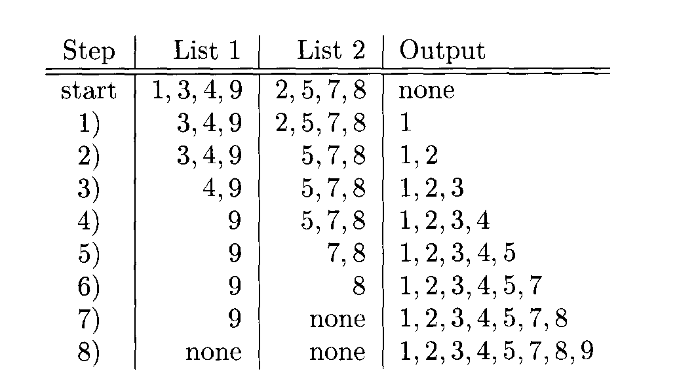
Merging two sorted lists to make one sorted list

Slide 65
Merge-Sort
The time to merge in main memory is linear in the sum of the lengths of the lists. The reason is that, because the given lists are sorted, only the heads of the two lists are ever candidates for being the smallest unselected element, and we can compare them in a constant amount of time. The classic merge-sort algorithm sorts recursively, using log₂ n phases if there are n elements to be sorted. It can be described as follows:
BASIS: If there is a list of one element to be sorted, do nothing, because the list is already sorted.
INDUCTION: If there is a list of more than one element to be sorted, then divide the list arbitrarily into two lists that are either of the same length, or as close as possible if the original list is of odd length. Recursively sort the two sublists. Then merge the resulting sorted lists into one sorted list.
The analysis of this algorithm is well known and not too important here. Briefly T(n), the time to sort n elements, is some constant times n (to split the list and merge the resulting sorted lists) plus the time to sort two lists of size n/2. That is, T(n) = 2T(n/2) + an for some constant a. The solution to this recurrence equation is T(n) = O(n logn), that is, proportional to n log n.

Slide 66
Two-Phase, Multiway Merge-Sort
We shall use a variant of Merge-Sort, called Two-Phase, Multiway Merge-Sort (often abbreviated TPMMS), to sort the relation of previous example on the machine described in that example. It is the preferred sorting algorithm in many database applications. Briefly, this algorithm consists of:
Phase 1: Sort main-memory-sized pieces of the data, so every record is part of a sorted list that just fits in the available main memory. There may thus be any number of these sorted sublists, which we merge in the next phase.
Phase 2: Merge all the sorted sublists into a single sorted list.
At the end of this first phase, all the records of the original relation will have been read once into main memory, and become part of a main-memory-size sorted sublist that has been written onto disk.

Slide 67
Example
Consider the relation described in previous example. We determined that 6400 of the 100,000 blocks will fill main memory. We thus fill memory 16 times, sort the records in main memory, and write the sorted sub- lists out to disk. The last of the 16 sublists is shorter than the rest; it occupies only 4000 blocks, while the other 15 sublists occupy 6400 blocks.
How long does this phase take? We read each of the 100,000 blocks once, and we write 100,000 new blocks. Thus, there are 200,000 disk I/O’s. We have assumed, for the moment, that blocks are stored at random on the disk, an assumption that, as we shall see in later, can be improved upon greatly. However, on our randomness assumption, each block read or write takes about 11 milliseconds. Thus, the I/O time for the first phase is 2200 seconds, or 37 minutes, or over 2 minutes per sorted sublist. It is not hard to see that, at a processor speed of hundreds of millions of instructions per second, we can create one sorted sublist in main memory in far less than the I/O time for that sublist. We thus estimate the total time for phase one as 37 minutes.

Slide 68
Two-Phase, Multiway Merge-Sort
Now, let us consider how we complete the sort by merging the sorted sublists. We could merge them in pairs, as in the classical Merge-Sort, but that would involve reading all data in and out of memory 2 log₂ n times if there were n sorted sublists. For instance, the 16 sorted sublists of previous example would be read in and out of secondary storage once to merge into 8 lists; another complete reading and writing would reduce them to 4 sorted lists, and two more complete read/write operations would reduce them to one sorted list. Thus, each block would have 8 disk I/O’s performed on it.
A better approach is to read the first block of each sorted sublist into a main-memory buffer. For some huge relations, there would be too many sorted sublists from phase one to read even one block per list into main memory, a problem we shall deal with later. But for data such as that of previous example, there are relatively few lists, 16 in that example, and a block from each list fits easily in main memory.
We also use a buffer for an output block that will contain as many of the first elements in the complete sorted list as it can hold. Initially, the output block is empty. The arrangement of buffers is suggested by next figure. We merge the sorted sublists into one sorted list with all the records as follows.

Slide 69
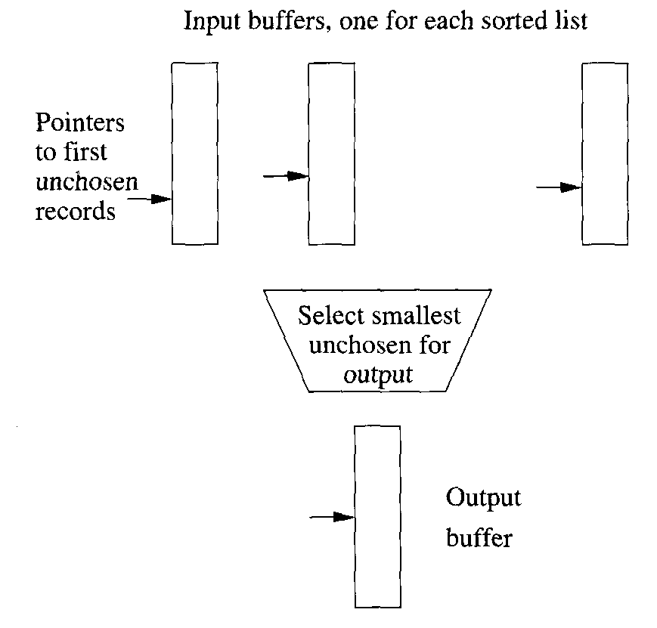
Main-memory organization for multiway merging

Slide 70
Two-Phase, Multiway Merge- Sort
Find the smallest key among the first remaining elements of all the lists. Since this comparison is done in main memory, a linear search is sufficient, taking a number of machine instructions proportional to the number of sublists. However, if we wish, there is a method based on “priority queues” that takes time proportional to the logarithm of the number of sublists to find the smallest element.
Move the smallest element to the first available position of the output block.
If the output block is full, write it to disk and reinitialize the same buffer in main memory to hold the next output block.
If the block from which the smallest element was just taken is now exhausted of records, read the next block from the same sorted sublist into the same buffer that was used for the block just exhausted. If no blocks remain, then leave its buffer empty and do not consider elements from that list in any further competition for smallest remaining elements.

Slide 71
Two-Phase, Multiway Merge-Sort
In the second phase, unlike the first phase, the blocks are read in an unpredictable order, since we cannot tell when an input block will become exhausted. However, notice that every block holding records from one of the sorted lists is read from disk exactly once. Thus, the total number of block reads is 100,000 in the second phase, just as for the first. Likewise, each record is placed once in an output block, and each of these blocks is written to disk. Thus, the number of block writes in the second phase is also 100,000. As the amount of second phase computation in main memory can again be neglected compared to the I/O cost, we conclude that the second phase takes another 37 minutes, or 74 minutes for the entire sort.

Slide 72
How Big Should Blocks Be?
We have assumed a 16K byte block in our analysis of algorithms using the Megatron 747 disk. However, there are arguments that a larger block size would be advantageous. Recall from previous example that it takes about a quarter of a millisecond for transfer time of a 16K block and 10.63 milliseconds for average seek time and rotational latency. If we doubled the size of blocks, we would halve the number of disk I/O’s for an algorithm like TPMMS. On the other hand, the only change in the time to access a block would be that the transfer time increases to 0.50 millisecond. We would thus approximately halve the time the sort takes. For a block size of 512K (i.e., an entire track of the Megatron 747) the transfer time is 8 milliseconds. At that point, the average block access time would be 20 milliseconds, but we would need only 12,500 block accesses, for a speedup in sorting by a factor of 14.
However, there are reasons to limit the block size. First, we cannot use blocks that cover several tracks effectively. Second, small relations would occupy only a fraction of a block, so large blocks would waste space on the disk. There are also certain data structures for secondary storage organization that prefer to divide data among many blocks and therefore work less well when the block size is too large. In fact, we shall see later that the larger the blocks are, the fewer records we can sort by TPMMS. Nevertheless, as machines get faster and disks more capacious, there is a tendency for block sizes to grow.

Slide 73
Multiway Merging of Larger Relations
The Two-Phase, Multiway Merge-Sort (TPMMS) described above can be used to sort some very large sets of records. To see how large, let us suppose that:
The block size is B bytes.
The main memory available for buffering blocks is M bytes.
Records take R bytes.
The number of buffers available in main memory is thus M/B. On the second phase, all but one of these buffers may be devoted to one of the sorted sublists; the remaining buffer is for the output block. Thus, the number of sorted sublists that may be created in phase one is (M/B) - 1. This quantity is also the number of times we may fill main memory with records to be sorted. Each time we fill main memory, we sort M/R records. Thus, the total number of records we can sort is (M/R) ((M/B) - 1), or approximately M²/RB records.

Slide 74
Example
If we use the parameters outlined in previous example, then M = 104,857,600, B = 16,384, and R = 160. We can thus sort up to M²/RB = 4.2 billion records, occupying two thirds of a terabyte. Note that relations this size will not fit on a Megatron 747 disk.

Slide 75
Multiway Merging of Larger Relations
If we need to sort more records, we can add a third pass. Use TPMMS to sort groups of M²/RB records, turning them into sorted sublists. Then, in a third phase, we merge up to (M/B) - 1 of these lists in a final multiway merge.
The third phase lets us sort approximately M³/RB² records occupying M³/B³ blocks. For the parameters of our example, this amount is about 27 trillion records occupying 4.3 petabytes. Such an amount is unheard of today. Since even the 0.67 terabyte limit for TPMMS is unlikely to be carried out in secondary storage, we suggest that the two-phase version of Multiway Merge-Sort is likely to be enough for all practical purposes.

Slide 76
Accelerating Access to Secondary Storage
The analysis we assumed that data was stored on a single disk and that blocks were chosen randomly from the possible locations on the disk. That assumption may be appropriate for a system that is executing a large number of small queries simultaneously. But if all the system is doing is sorting a large relation, then we can save a significant amount of time by being judicious about where we put the blocks involved in the sort, thereby taking advantage of the way disks work. In fact, even if the load on the system is from a large number of unrelated queries accessing “random” blocks on disk, we can do a number of things to make the queries run faster and/or allow the system to process more queries in the same time (“increase the throughput”).

Slide 77
Accelerating Access to Secondary Storage
Among the strategies we shall consider in this section are:
Place blocks that are accessed together on the same cylinder so we can often avoid seek time, and possibly rotational latency as well.
Divide the data among several smaller disks rather than one large one. Having more head assemblies that can go after blocks independently can increase the number of block accesses per unit time.
Mirror a disk: making two or more copies of the data on single disk. In addition to saving the data in case one of the disks fails, this strategy, like dividing the data among several disks, lets us access several blocks at once.
Use a disk-scheduling algorithm, either in the operating system, in the DBMS, or in the disk controller, to select the order in which several requested blocks will be read or written,
Prefetch blocks to main memory in anticipation of their later use.

Slide 78
Accelerating Access to Secondary Storage
In our discussion, we shall emphasize the improvements possible when the system is dedicated, at least momentarily, to doing a particular task such as the sorting operation we introduced. However, there are at least two other viewpoints with which to measure the performance of systems and their use of secondary storage:
What happens when there are a large number of processes being supported simultaneously by the system? An example is an airline reservation system that accepts queries about flights and new bookings from many agents at the same time.
What do we do if we have a fixed budget for a computer system, or we must execute a mix of queries on a system that is already in place and not easily changed?
We address these questions later after exploring the options.

Slide 79
Organizing Data by Cylinders
Since seek time represents about half the average time to access a block, there are a number of applications where it makes sense to store data that is likely to be accessed together, such as relations, on a single cylinder. If there is not enough room, then several adjacent cylinders can be used.
In fact, if we choose to read all the blocks on a single track or on a cylinder consecutively, then we can neglect all but the first seek time (to move to the cylinder) and the first rotational latency (to wait until the first of the blocks moves under the head). In that case, we can approach the theoretical transfer rate for moving data on or off the disk.

Slide 80
Example
Let us review the performance of TPMMS. Recall that we determined the average block transfer time, seek time, and rotational latency to be 0.25 milliseconds, 6.46 milliseconds, and 4.17 milliseconds, respectively, for the Megatron 747 disk. We also found that the sorting of 10,000,000 records occupying a gigabyte took about 74 minutes. This time was divided into four components, one for reading and one for writing in each of the two phases of the algorithm.
Let us consider whether the organization of data by cylinders can improve the time of these operations. The first operation was the reading of the original records into main memory. Recall that we loaded main memory 16 times, with 6400 blocks each time.
The original 100,000 blocks of data may be stored on consecutive cylinders. Each of the 16,384 cylinders of the Megatron 747 stores about eight megabytes on 512 blocks; technically this figure is an average, because inner tracks store less and outer tracks more, but for simplicity we shall assume all tracks and cylinders are average. We must thus store the initial data on 196 cylinders, and we must read from 13 different cylinders to fill main memory once.
We can read one cylinder with a single seek time. We do not even have to wait for any particular block of the cylinder to pass under the head, because the order of records read is not important at this phase. We must move the heads 12 times to adjacent cylinders, but recall that a move of one track takes only one millisecond according to the parameters. The total time to fill main memory is thus:
6.46 milliseconds for one average seek.
12 milliseconds ?or 12 one-cylinder seeks.
1.60 seconds for the transfer of 6400 blocks.

Slide 81
Example
All but the last quantity can be neglected. Since we fill memory 16 times, the total reading time for phase 1 is about 26 seconds. This number should be compared with the 18 minutes that the reading part of phase 1 takes when we assumed blocks were distributed randomly on disk. The writing part of phase 1 can likewise use adjacent cylinders to store the 16 sorted sublists of records. They can be written out onto another 196 cylinders, using the same head motions as for reading: one random seek and 12 one-cylinder seeks for each of the 16 lists. Thus, the writing time for phase 1 is also about 26 seconds, or 52 seconds for all of phase 1, compared with 37 minutes when randomly distributed blocks were used.
On the other hand, storage by cylinders does not help with the second phase of the sort. Recall that in the second phase, blocks are read from the fronts of the 16 sorted sublists in an order that is determined by the data and by which list next exhausts its current block. Likewise, output blocks, containing the complete sorted list, are written one at a time, interspersed with block reads. Thus, the second phase will still take about 37 minutes. We have consequently cut the sorting time almost in half, but cannot do better by judicious use of cylinders alone.

Slide 82
Using Multiple Disks
We can often improve the speed of our system if we replace one disk, with many heads locked together, by several disks with their independent heads. The arrangement was suggested in the figure, where we showed three disks connected to a single controller. As long as the disk controller, bus, and main memory can handle the data transferred at a higher rate, the effect will be approximately as if all times associated with reading and writing the disk were divided by the number of disks. An example should illustrate the difference.

Slide 83
Example
The Megatron 737 disk has all the characteristics of the Megatron 747 outlined in examples, but it has only two platters and four surfaces. Thus, each Megatron 737 holds 32 gigabytes. Suppose that we replace our one Megatron 747 by four Megatron 737’s. Let us consider how TPMMS can be conducted.
First, we can divide the given records among the four disks; the data will occupy 196 adjacent cylinders on each disk. When we want to load main memory from disk during phase 1, we shall fill 1/4 of main memory from each of the four disks. We still get the benefit observed that the seek time and rotational latency go essentially to zero. However, we can read enough blocks to fill 1/4 of main memory, which is 1600 blocks, from a disk in about 400 milliseconds. As long as the system can handle data at this rate coming from four disks, we can fill the 100 megabytes of main memory in 0.4 seconds, compared with 1.6 seconds when we used one disk.
Similarly, when we write out main memory during phase 1, we can distribute each sorted sublist onto the four disks, occupying about 13 adjacent cylinders on each disk. Thus, there is a factor-of-4 speedup for the writing part of phase 1 too, and the entire phase 1 takes about 13 seconds, compared with 52 seconds using only the cylinder-based improvement and 37 minutes for the original, random approach.

Slide 84
Example
Now, let us consider the second phase of TPMMS. We must still read blocks from the fronts of the various lists in a seemingly random, data-dependent way. If the core algorithm of phase 2 — the selection of smallest remaining elements from the 16 sublists requires that all 16 lists be represented by blocks completely loaded into main memory, then we cannot use the four disks to advantage. Every time a block is exhausted, we must wait until a new block is read from the same list to replace it. Thus, only one disk at a time gets used.
However, if we write our code more carefully, we can resume comparisons among the 16 smallest elements as soon as the first element of the new block appears in main memory. (We should emphasize that this approach requires extremely delicate implementation and should only be attempted if there is an important benefit to doing so. There is a significant risk that, if we are not careful, there will be an attempt to read a record before it actually arrives in main memory.) If so, then several lists might be having their blocks loaded into main memory at the same time. As long as they are on separate disks, then we can perform several block reads at the same time, and we have the potential of a factor-of-4 increase in the speed of the reading part of phase 2. We are also limited by the random order in which blocks must be read; if the next two blocks we need happen to be on the same disk, then one has to wait for the other, and all main-memory processing stops until at least the beginning of the second arrives in main memory.
The writing part of phase 2 is easier to speed up. We can use four output buffers and fill each in turn. Each buffer, when full, is written to one particular disk, filling cylinders in order. We can thus fill one of the buffers while the other three are written out.
Nevertheless, we cannot possibly write out the complete sorted list faster than we can read the data from the 16 intermediate lists. As we saw above, it is not possible to keep all four disks doing useful work all the time, and our speedup for phase 2 is probably in the 2-3 times range. However, even a factor of 2 saves us 18 minutes. By using cylinders to organize data and four disks to hold data, we can reduce the time for our sorting example from 37 minutes for each of the two phases to 13 seconds for the first phase and 18 minutes for the second.

Slide 85
Mirroring Disks
There are situations where it makes sense to have two or more disks hold identical copies of data. The disks are said to be mirrors of each other. One important motivation is that the data will survive a head crash by either disk, since it is still readable on a mirror of the disk that crashed. Systems designed to enhance reliability often use pairs of disks as mirrors of each other.
However, mirror disks can also speed up access to data. Recall our discussion of phase 2 in previous example, where we observed that if we were very careful about timing, we could arrange to load up to four blocks from four different sorted lists whose previous blocks were exhausted. However, we could not choose which four lists would get new blocks. Thus, we could be unlucky and find that the first two lists were on the same disk, or two of the first three lists were on the same disk.
If we are willing to buy and use four copies of a single large disk, then we can guarantee that the system can always be retrieving four blocks at once. That is, no matter which four blocks we need, we can assign each block to any of the four disks and read the block off of that disk.
In general, if we make n copies of a disk, we can read any n blocks in parallel. Moreover, if we have fewer than n blocks to read at once, then we can often obtain a speed increase by judiciously choosing which disk to read from. That is, we can pick the available disk whose head is closest to the cylinder from which we desire to read.

Slide 86
Mirroring Disks
Using mirror disks does not speed up writing, but neither does it slow writing down, when compared with using a single disk. That is, whenever we need to write a block, we write it on all disks that have a copy. Since the writing can take place in parallel, the elapsed time is about the same as for writing to a single disk. There is a slight opportunity for differences among the writing times for the various mirror disks, because we cannot rely on them rotating in exact synchronism. Thus, one disk’s head might just miss a block, while another disk’s head might be about to pass over the position for the same block. However, these differences in rotational latency average out, and if we are using the cylinder-based strategy, then the rotational latency can be neglected anyway.

Slide 87
Disk Scheduling and the Elevator Algorithm
Another effective way to speed up disk accesses in some situations is to have the disk controller choose which of several requests to execute first. This opportunity is not useful when the system needs to read or write disk blocks in a certain sequence, such as is the case in parts of our running merge-sort example. However, when the system is supporting many small processes that each access a few blocks, one can often increase the throughput by choosing which process’ request to honor first.
A simple and effective way to schedule large numbers of block requests is known as the elevator algorithm. We think of the disk head as making sweeps across the disk, from innermost to outermost cylinder and then back again, just as an elevator makes vertical sweeps from the bottom to top of a building and back again. As heads pass a cylinder, they stop if there are one or more requests for blocks on that cylinder. All these blocks are read or written, as requested. The heads then proceed in the same direction they were traveling until the next cylinder with blocks to access is encountered. When the heads reach a position where there are no requests ahead of them in their direction of travel, they reverse direction.

Slide 88
Example
Suppose we are scheduling a Megatron 747 disk, which we recall has average seek, rotational latency, and transfer times of 6.46, 4.17, and 0.25, respectively (in this example, all times are in milliseconds). Suppose that at some time there are pending requests for block accesses at cylinders 2000, 6000, and 14,000. The heads are located at cylinder 2000. In addition, there are three more requests for block accesses that come in at later times, as summarized in next figure. For instance, the request for a block from cylinder 4000 is made at time 10 milliseconds.

Slide 89
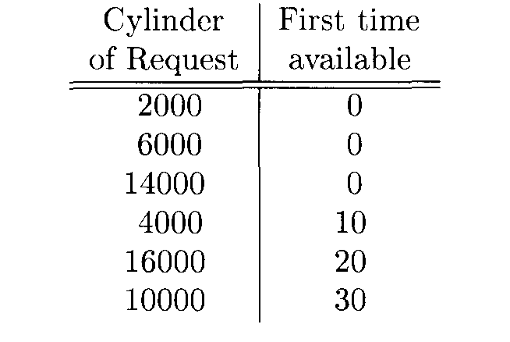
Arrival times for six block-access requests

Slide 90
Example
We shall assume that each block access incurs time 0.25 for transfer and 4.17 for average rotational latency, i.e., we need 4.42 milliseconds plus whatever the seek time is for each block access. The seek time can be calculated by the rule for the Megatron 747 given in previous example plus the number of tracks divided by 1000. Let us see what happens if we schedule by the elevator algorithm. The first request at cylinder 2000 requires no seek, since the heads are already there. Thus, at time 4.42 the first access will be complete. The request for cylinder 4000 has not arrived at this point, so we move the heads to cylinder 6000, the next requested “stop” on our sweep to the highest-numbered tracks. The seek from cylinder 2000 to 6000 takes 5 milliseconds, so we arrive at time 9.42 and complete the access in another 4.42. Thus, the second access is complete at time 13.84. By this time, the request for cylinder 4000 has arrived, but we passed that cylinder at time 7.42 and will not come back to it until the next pass.
We thus move next to cylinder 14,000, taking time 9 to seek and 4.42 for rotation and transfer. The third access is thus complete at time 27.26. Now, the request for cylinder 16,000 has arrived, so we continue outward. We require 3 milliseconds for seek time, so this access is complete at time 27.26+3+4.42 = 34.68.

Slide 91
Example
At this time, the request for cylinder 10,000 has been made, so it and the request at cylinder 4000 remain. We thus sweep inward, honoring these two requests. Figure 11.13 summarizes the times at which requests are honored.
Let us compare the performance of the elevator algorithm with a more naive approach such as first-come-first-served. The first three requests are satisfied in• exactly the same manner, assuming that the order of the first three requests was 2000, 6000, and 14,000. However, at that point, we go to cylinder 4000, because that was the fourth request to arrive. The seek time is 11 for this request, since we travel from cylinder 14,000 to 4000, more than half way across the disk. The fifth request, at cylinder 16,000, requires a seek time of 13, and the last, at 10,000, uses seek time 7. Next figure summarizes the activity caused by first-come-first-serve scheduling. The difference between the two algorithms 14 milliseconds may not appear significant, but recall that the number of requests in this simple example is small and the algorithms were assumed not to deviate until the fourth of the six requests.

Slide 92
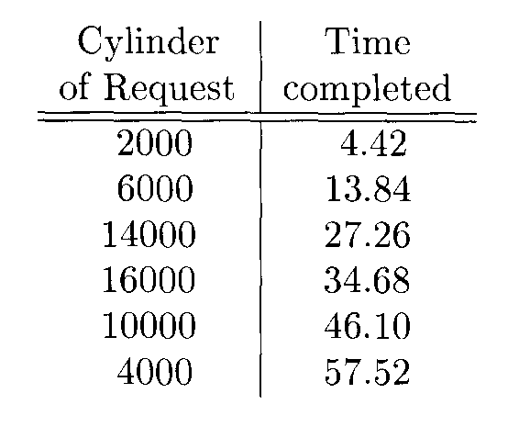
Finishing times for block accesses using the elevator algorithm

Slide 93
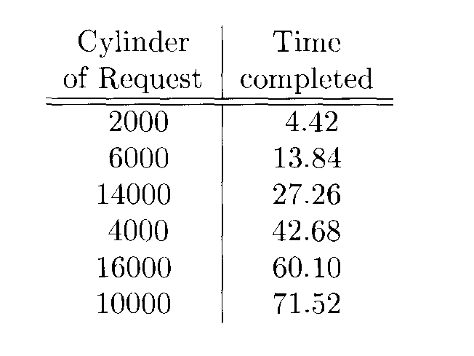
Finishing times for block accesses using the first-come-first-served algorithm

Slide 94
Disk Scheduling and the Elevator Algorithm
If the average number of requests waiting for the disk increases, the elevator algorithm further improves the throughput. For instance, should the pool of waiting requests equal the number of cylinders, then each seek will cover but a few cylinders, and the average seek time will approximate the minimum. If the pool of requests grows beyond the number of cylinders, then there will typically be more than one request at each cylinder. The disk controller can then order the requests around the cylinder, reducing the average rotational latency as well as the average seek time. However, should request pools grow that big, the time taken to serve any request becomes extremely large An example should illustrate the situation.

Slide 95
Example
Suppose again we are operating a Megatron 747 disk, with its 16,384 cylinders. Imagine that there are 1000 disk access requests waiting. For simplicity, assume that these are all for blocks on different cylinders, spaced 16 apart. If we start at one end of the disk and sweep across, each of the 1000 requests has just a fraction more than 1 millisecond for seek time, 4.17 milliseconds for rotational latency, and 0.25 milliseconds for transfer. We can thus satisfy one request every 5.42 milliseconds, about half the 10.88 millisecond average time for random block accesses. However, the entire 1000 accesses take 5.42 seconds, so the average delay in satisfying a request is half that, or 2.71 seconds, a quite noticeable delay.
Now, suppose the pool of requests is as large as 32,768, which we shall assume for simplicity is exactly two accesses per cylinder. In this case, each seek time is one millisecond (0.5 per access), and of course the transfer time is 0.25 millisecond. Since there are two blocks accessed on each cylinder, on average the further of the two blocks will be 2/3 of the way around the disk when the heads arrive at that track. The proof of this estimate is tricky; we explain it in the box entitled “Waiting for the Last of Two Blocks.”
Thus the average latency for these two blocks will be half of 2/3 of the time for a single revolution, or 1/2 x 2/3 x 8.33 = 2.78 milliseconds. We thus have reduced the average time to access a block to 0.5+0.25+2.78 = 3.53 milliseconds, about a third the average time for first-come-first-served scheduling. On the other hand, the 32,768 accesses take a total of 116 seconds, so the average delay in satisfying a request is almost a minute.

Slide 96
Prefetching and Large-Scale Buffering
Our final suggestion for speeding up some secondary-memory algorithms is called prefetching or sometimes double buffering. In some applications we can predict the order in which blocks will be requested from disk. If so, then we can load them into main memory buffers before they are needed. One advantage to doing so is that we are thus better able to schedule the disk, such as by using the elevator algorithm, to reduce the average time needed to access a block. We could gain the speedup in block access suggested by previous example without the long delay in satisfying requests that we also saw in that example.

Slide 97
Example
For an example of the use of double buffering, let us again focus on the second phase of TPMMS. Recall that we merged 16 sorted sublists by bringing into main memory one block from each list. If we had so many sorted sublists to merge that one block from each would fill main memory, then we could not do any better. But in our example, there is plenty of main memory left over. For instance, we could devote two block buffers to each list and fill one buffer while records were being selected from the other during the merge. When a buffer is exhausted, we switch to the other buffer for the same list, with no delay.

Slide 98
Prefetching and Large-Scale Buffering
However, the scheme of previous example still takes whatever time is required to read all 100,000 blocks of the sorted sublists. We could combine prefetching with the cylinder-based strategy if we:
Store the sorted sublists on whole, consecutive cylinders, with the blocks on each track being consecutive blocks of the sorted sublist.
Read whole tracks or whole cylinders whenever we need some more records from a given list.

Slide 99
Waiting for the Last of Two Blocks
Suppose there are two blocks at random positions around a cylinder. Let x₁ and x₂ be the positions, in fractions of the full circle, so these are numbers between 0 and 1. The probability that both x₁ and x₂ are less than some number y between 0 and 1 is y². Thus, the probability density for y is the derivative of y², or 2y. That is, the probability that g has a given value increases linearly, as g grows from 0 to 1. The average of y is the integral of p times the probability density of y, that is ∫₀¹ 2y² or 2/3.

Slide 100
Example
To appreciate the benefit of track-sized or cylinder-sized reads, again let us consider the second phase of TPMMS. We have room in main memory for two track-sized buffers for each of the 16 lists. Recall a track of the Megatron 747 holds half a megabyte, so the total space requirement is 16 megabytes of main memory. We can read a track starting at any sector, so the time to read a track is essentially the average seek time plus the time for the disk to rotate once, or 6.46 + 8.33 = 14.79 milliseconds. Since we must read all the blocks on 196 cylinders, or 3136 tracks, to read the 16 sorted sublists, the total time for reading of all data is about 46 seconds.
We can do even better if we use two cylinder-sized buffers per sorted sublist, and fill one while the other is being used. Since there are 16 tracks on a cylinder of the Megatron 747, we would need 32 buffers of 4 megabytes each, or 128 megabytes. We said that there was only 100 megabytes of main memory available, but 128 megabytes is quite reasonable as a main-memory size.
Using cylinder-sized buffers, we need only do a seek once per cylinder. The time to seek and read all 16 tracks of a cylinder is thus 6.46 + 16 x 8.33 140 milliseconds. The time to read all 196 cylinders is 196 times as long, or about 27 seconds.

Slide 101
Prefetching and Large-Scale Buffering
The ideas just discussed for reading have their analogs for writing. In the spirit of prefetching, we can delay the writing of buffered blocks, as long as we don’t need to reuse the buffer immediately. This strategy allows us to avoid delays while we wait for a block to be written out.
However, much more powerful is the strategy of using large output buffers track-sized or cylinder-sized. If our application permits us to write in such large chunks, then we can essentially eliminate seek time and rotational latency, and write to disk at the maximum transfer rate of the disk. For instance, if we modified the writing part of the second phase of our sorting algorithm so there were two output buffers of 4 megabytes each, then we could fill one buffer with sorted records, and write it to a cylinder at the same time we filled the other output buffer with the next sorted records. Then, the writing time would be 27 seconds, like the reading time in previous example, and the entire phase 2 would take under a minute, just like the improved phase 1 of previous example. A combination of the tricks of storing data on whole cylinders, cylinder-sized buffering, and prefetching has given us a sort in less than two minutes that takes 74 minutes by a naive disk-management strategy.

Slide 102
Summary of Strategies and Tradeoffs
We have seen five different “tricks” that can sometimes improve the performance of a disk system. They are:
Organizing data by cylinders.
Using several disks in place of one.
Mirroring disks.
Scheduling requests by the elevator algorithm.
Prefetching data in track- or cylinder-sized chunks.
We also considered their effect on two situations, which represent the extremes of disk-access requirements:
A very regular situation, exemplified by phase 1 of TPMMS, where blocks can be read and written in a sequence that can be predicted in advance, and there is only one process using the disk.
A collection of short processes, such as airline reservations or bank-account changes, that execute in parallel, share the same disk(s), and cannot be predicted in advance. Phase 2 of TPMMS has some of these characteristics.
Below we summarize the advantages and disadvantages of each of these methods for these applications and those in between.

Slide 103
Cylinder-Based Organization
Advantage: Excellent for type (a) applications, where accesses can be predicted in advance, and only one process is using the disk.
Disadvantage: No help for type (b) applications, where accesses are unpredictable.

Slide 104
Multiple Disks
Advantage: Increases the rate at which read/write requests can be satisfied, for both types of applications.
Problem: Read or write requests for the same disk cannot be satisfied at the same time, so speedup factor may be less than the factor by which the number of disks increases.
Disadvantage: The cost of several small disks exceeds the cost of a single disk with the same total capacity.

Slide 105
Mirroring
Advantage: Increases the rate at which read/write requests can be satisfied, for both types of applications; does not have the problem of colliding accesses mentioned for multiple disks.
Advantage: Improves fault tolerance for all applications.
Disadvantage: We must pay for two or more disks but get the storage capacity of only one.

Slide 106
Elevator Algorithm
Advantage: Reduces the average time to read/write blocks when the accesses to blocks are unpredictable.
Problem: The algorithm is most effective in situations where there are many waiting disk-access requests and therefore the average delay for the requesting processes is high.

Slide 107
Prefetching/Double Buffering
Advantage: Speeds up access when the needed blocks are known but the timing of requests is data-dependent, as in phase 2 of TPMMS.
Disadvantage: Requires extra main-memory buffers. No help when accesses are random.

Slide 108
Disk Failures
Now we shall consider the ways in which disks can fail and what can be done to mitigate these failures.
The most common form of failure is an intermittent failure, where an attempt to read or write a sector is unsuccessful, but with repeated tries we are able to read or write successfully,
A more serious form of failure is one in which a bit or bits are permanently corrupted, and it becomes impossible to read a sector correctly no matter how many times we try. This form of error is called media decay.
A related type of error is a write failure, where we attempt to write a sector, but we can neither write successfully nor can we retrieve the previously written sector. A possible cause is that there was a power outage during the writing of the sector,
The most serious form of disk failure is a disk crash, where the entire disk becomes unreadable, suddenly and permanently.
Here, we consider a simple model of disk failures. We cover parity checks as a way to detect intermittent failures. We also discuss “stable storage,” a technique for organizing a disk so that media decays or failed writes do not result in permanent loss. Next, we examine techniques collectively known as “RAID” for coping with disk crashes.

Slide 109
Intermittent Failures
Disk sectors are ordinarily stored with some redundant bits, which we discuss. The purpose of these bits is to enable us to tell whether what we are reading from the sector is correct or not; they similarly allow us to tell whether a sector we wrote has been written correctly.
A useful model of disk reads is that the reading function returns a pair (w,s), where w is the data in the sector that is read, and s is a status bit that tells whether or not the read was successful; i.e., whether or not we can rely on w being the true contents of the sector. In an intermittent failure, we may get a status “bad” several times, but if the read function is repeated enough times (100 times is a typical limit), then eventually a status “good” will be returned, and we rely on the data returned with this status to be the correct contents of the disk sector. As we shall see later, there is a chance that we are being fooled; the status is “good” but the data returned is wrong. However, we can make the probability of this event as low as we like, if we add more redundancy to the sectors.

Slide 110
Intermittent Failures
Writing of sectors can also profit by observing the status of what we write. As we mentioned, we may try to read each sector after we write it and determine whether the write was successful. A straightforward way to perform the check is to read the sector and compare it with the sector we intended to write. However, instead of performing the complete comparison at the disk controller, it is simpler to attempt to read the sector and see if its status is “good.” If so, we assume the write was correct, and if the status is “bad” then the write was apparently unsuccessful and must be repeated. Notice that, as with reading, we can be fooled if the status is “good” but the write was actually unsuccessful. Also as with reading, we can make the probability of such an event as small as we like.

Slide 111
Checksums
How a reading operation can determine the good/bad status of a sector may appear mysterious at first. Yet the technique used in modern disk drives is quite simple: each sector has some additional bits, called the checksum, that are set depending on the values of the data bits stored in that sector. If, on reading, we find that the checksum is not proper for the data bits, then we return status “bad”; otherwise we return “good.” While there is a small probability that the data bits may be misread, but the incorrect bits happen to have the same checksum as the correct bits (and therefore incorrect bits will be given the status “good”), by using a sufficiently large number of checksum bits, we can reduce this probability to whatever small level we wish.
A simple form of checksum is based on the parity of all the bits in the sector. If there is an odd number of l’s among a collection of bits, we say the bits have odd parity, or that their parity bit is 1. Similarly, if there is an even number of l’s among the bits, then we say the bits have even parity, or that their parity bit is 0. As a result:
The number of l’s among a collection of bits and their parity bit is always even.
When we write a sector, the disk controller can compute the parity bit and append it to the sequence of bits written in the sector. Thus, every sector will have even parity.

Slide 112
Example
If the sequence of bits in a sector were 01101000, then there is an odd number of l’s, so the parity bit is 1. If we follow this sequence by its parity bit we have 011010001. If the given sequence of bits were 11101110, we have an even number of l’s, and the parity bit is 0. The sequence followed by its parity bit is 111011100. Note that each of the nine-bit sequences constructed by adding a parity bit has even parity.

Slide 113
Checksums
Any one-bit error in reading or writing the bits and their parity bit results in a sequence of bits that has odd parity; i.e., the number of l’s is odd. It is easy for the disk controller to count the number of l’s and to determine the presence of an error if a sector has odd parity.
Of course, more than one bit of the sector may be corrupted. If so, the probability is 50% that the number of 1-bits will be even, and the error will not be detected. We can increase our chances of detecting even large numbers of errors if we keep several parity bits. For example, we could keep eight parity bits, one for the first bit of every byte, one for the second bit of every byte, and so on, up to the eighth and last bit of every byte. Then, on a massive error, the probability is 50% that any one parity bit will detect an error, and the chance that none of the eight do so is only one in 2⁸, or 1/256. In general, if we use n independent bits as a checksum, then the chance of missing an error is only l/2^{n}. For instance, if we devote 4 bytes to a checksum, then there is only one chance in about four billion that the error will go undetected.

Slide 114
Stable Storage
While checksums will almost certainly detect the existence of a media failure or a failure to read or write correctly, it does not help us correct the error. Moreover, when writing we could find ourselves in a position where we overwrite the previous contents of a sector and yet cannot read the new contents. That situation could be serious in a situation where, say, we were adding a small increment to an account balance and have now lost both the original balance and the new balance. If we could be assured that the contents of the sector contained either the new or old balance, then we would only have to determine whether the write was successful or not.

Slide 115
Stable Storage
To deal with the problems above, we can implement a policy known as stable storage on a disk or on several disks. The general idea is that sectors are paired, and each pair represents one sector-contents X. We shall refer to the pair of sectors representing X as the “left” and “right” copies, X_{L} and X_{R}. We continue to assume that the copies are written with a sufficient number of parity-check bits so that we can rule out the possibility that a bad sector looks good when the parity checks are considered. Thus, we shall assume that if the read function returns (w, good) for either X_{L} or X_{R}, then w is the true value of X. The stable-storage writing policy is:
Write the value of X into X_{L}. Check that the value has status “good”; i.e., the parity-check bits are correct in the written copy. If not, repeat the write. If after a set number of write attempts, we have not successfully written X into X_{L}, assume that there is a media failure in this sector. A fix-up such as substituting a spare sector for X_{L} must be adopted.
Repeat (1) for X_{R}.

Slide 116
Stable Storage
The stable-storage reading policy is:
To obtain the value of X, read X_{L}. If status “bad” is returned, repeat the read a set number of times. If a value with status “good” is eventually returned, take that value as X.
If we cannot read X_{L}, repeat (1) with X_{R}.

Slide 117
Error-Handling Capabilities of Stable Storage
The policies described are capable of compensating for several different kinds of errors. We shall outline them here.
Media failures. If, after storing X in sectors X_{L} and X_{R}, one of them undergoes a media failure and becomes permanently unreadable, we can always read X from the other. If X_{R} has failed but X_{L} has not, then the read policy will correctly read X_{L} and not even look at X_{R}; we shall discover that X_{R} is failed when we next try to write a new value for X. If only X_{L} has failed, then we shall not be able to get a “good” status for X in any of our attempts to read X_{L} (recall that we assume a bad sector will always return status “bad,” even though in reality there is a tiny chance that “good” will be returned because all the parity-check bits happen to match). Thus, we proceed to step (2) of the read algorithm and correctly read X from X_{R}. Note that if both X_{L} and X_{R} have failed, then we cannot read X, but the probability of both failing is extremely small.

Slide 118
Error-Handling Capabilities of Stable Storage
Write failure. Suppose that as we write X, there is a system failure e.g., a power outage. It is possible that X will be lost in main memory, and also the copy of X being written at the time will be garbled. For example, half the sector may be written with part of the new value of X, while the other half remains as it was. When the system becomes available and we examine X_{L} and X_{R}, we are sure to be able to determine either the old or new value of X. The possible cases are:
The failure occurred as we were writing X_{L}. Then we shall find that the status of X_{L} is “bad.” However, since we never got to write X_{R}, its status will be “good” (unless there is a coincident media failure at X_{R}, which we rule out as extremely unlikely). Thus, we can obtain the old value of X. We may also copy X_{R} into X to repair the damage to X_{L}.
The failure occurred after we wrote X_{L}. Then we expect that X_{L} will have status “good,” and we may read the new value of X from X_{L}. Note that X_{R} may have status bad, and we should copy X_{L} into X_{R} if so.

Slide 119
Recovery from Disk Crashes
Now, we shall consider the most serious mode of failure for disks - the “head crash,” where data is permanently destroyed. In this event, if data is not backed up on another medium, such as a tape backup system, or on a mirror disk as we discussed, then there is nothing we can do to recover the data. This situation represents a disaster for major DBMS applications, such as banking and other financial applications, airline or other reservation-booking databases, inventory-management systems, and many others.
There are a number of schemes that have been developed to reduce the risk of data loss by disk crashes. They generally involve redundancy, extending the idea of parity checks, as discussed, or duplicated sectors. The common term for this class of strategies is RAID, or Redundant Arrays of Independent Disks. (Previously, the acronym RAID was translated as “Redundant Array of Inexpensive Disks,” and this meaning may still appear in literature. ) Here, we shall discuss primarily three schemes, called RAID levels 4, 5, and 6. These RAID schemes also handle failures in the modes discussed: media failures and corruption of data in a single sector due to a temporary system failure.

Slide 120
The Failure Model for Disks
To begin our discussion of disk crashes, we need to consider first the statistics of such failures. The simplest way to describe failure behavior is through a measurement known as mean time to failure. This number is the length of time by which 50% of a population of disks will have failed catastrophically, i.e., had a head crash so they are no longer readable. For modern disks, the mean time to failure is about 10 years.
The simplest way to use this number is to assume that one-tenth of all disks fail in a given year, in which case the survival percentage would be an exponentially decaying function. More realistically, the survival percentage of disks looks more like next figure. As for most types of electronic equipment, many disk failures occur early in the life cycle, due to tiny defects in the manufacture of that disk. Hopefully, most of these are caught before the disk leaves the factory, but some do not show up for months. A disk that does not suffer an early failure will probably serve for many years. Later in the life cycle, factors such as “wear-and-tear” and the accumulated effects of tiny dust particles increase the chances of a crash.

Slide 121
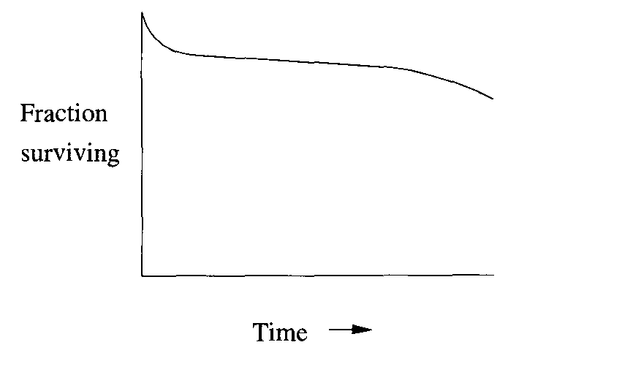
A survival rate curve for disks

Slide 122
The Failure Model for Disks
However, the mean time to a disk crash does not have to be the same as the mean time to data loss. The reason is that there are a number of schemes available for assuring that if one disk fails, there are others to help recover the data of the failed disk. In the balance of this section, we shall study the most common schemes.
Each of these schemes starts with one or more disks that hold the data (we’ll call these the data disks) and adding one or more disks that hold information that is completely determined by the contents of the data disks. The latter are called redundant disks. When there is a disk crash of either a data disk or a redundant disk, the other disks can be used to restore the failed disk, and there is no permanent information loss.

Slide 123
Mirroring as a Redundancy Technique
The simplest scheme is to mirror each disk, as discussed. We shall call one of the disks the data disk, while the other is the redundant disk; which is which doesn’t matter in this scheme. Mirroring, as a protection against data loss, is often referred to as RAID level 1. It gives a mean time to memory loss that is much greater than the mean time to disk failure, as the following example illustrates. Essentially, with mirroring and the other redundancy schemes we discuss, the only way data can be lost is if there is a second disk crash while the first crash is being repaired.

Slide 124
Example
Suppose each disk has a 10 year mean time to failure, which we shall take to mean that the probability of failure in any given year is 10%. If disks are mirrored, then when a disk fails, we have only to replace it with a good disk and copy the mirror disk to the new one. At the end, we have two disks that are mirrors of each other, and the system is restored to its former state.
The only thing that could go wrong is that during the copying the mirror disk fails. Now, both copies of at least part of the data have been lost, and there is no way to recover.
But how often will this sequence of events occur? Suppose that the process of replacing the failed disk takes 3 hours, which is 1/8 of a day, or 1/2920 of a year. Since we assume the average disk lasts 10 years, the probability that the mirror disk will fail during copying is (1/10) x (1/2920), or one in 29,200. If one disk fails every 10 years, then one of the two disks will fail once in 5 years on the average. One in every 29,200 of these failures results in data loss. Put another way, the mean time to a failure involving data loss is 5 x 29,200 = 146,000 years.

Slide 125
Parity Blocks
While mirroring disks is an effective way to reduce the probability of a disk crash involving data loss, it uses as many redundant disks as there are data disks. Another approach, often called RAID level 4, uses only one redundant disk no matter how many data disks there are. We assume the disks are identical, so we can number the blocks on each disk from 1 to some number n. Of course, all the blocks on all the disks have the same number of bits; for instance, the 16,384-byte blocks in our Megatron 747 running example have 8 x 16,384 = 131,072 bits. In the redundant disk, the ith block consists of parity checks for the ith blocks of all the data disks. That is, the jth bits of all the ith blocks, including both the data disks and the redundant disk, must have an even number of l’s among them, and we always choose the bit of the redundant disk to make this condition true.
We saw how to force the condition to be true. In the redundant disk, we choose bit j to be 1 if an odd number of the data disks have 1 in that bit, and we choose bit j of the redundant disk to be 0 if there are an even number of l’s in that bit among the data disks. The term for this calculation is the modulo-2 sum. That is, the modulo-2 sum of bits is 0 if there are an even number of l’s among those bits, and 1 if there are an odd number of l’s.

Slide 126
Example
Suppose for sake of an extremely simple example that blocks consist of only one byte eight bits. Let there be three data disks, called 1, 2, and 3, and one redundant disk, called disk 4. Focus on, say, the first block of all these disks. If the data disks have in their first blocks the following bit sequences:
disk 1: 11110000
disk 2: 10101010
disk 3: 00111000
then the redundant disk will have in block 1 the parity check bits:
disk 4: 01100010
Notice how in each position, an even number of the four 8-bit sequences have l’s. There are two l’s in positions 1, 2, 4, 5, and 7, four l’s in position 3, and zero l’s in positions 6 and 8.

Slide 127
Reading
Reading blocks from a data disk is no different from reading blocks from any disk. There is generally no reason to read from the redundant disk, but we could. In some circumstances, we can actually get the effect of two simultaneous reads from one of the data disks; the following example shows how, although the conditions under which it could be used are expected to be rare.

Slide 128
Example
Suppose we are reading a block of the first data disk, and another request comes in to read a different block, say block 1, of the same data disk. Ordinarily, we would have to wait for the first request to finish. However, if none of the other disks are busy, we could read block I from each of them, and compute block 1 of the first disk by taking the modulo-2 sum.
Specifically, if the disks and their first blocks were as in previous example, then we could read the second and third data disks and the redundant disk, to get the following blocks:
disk 2: 10101010
disk 3: 00111000
disk 4: 01100010
If we take the modulo-2 sum of the bits in each column, we get
disk 1: 11110000
which is the same as block 1 of the first disk.

Slide 129
Writing
When we write a new block of a data disk, we need not only to change that block, but we need to change the corresponding block of the redundant disk so it continues to hold the parity checks for the corresponding blocks of all the data disks. A naive approach would read the corresponding blocks of the n data disks, take their modulo-2 sum, and rewrite the block of the redundant disk. That approach requires a write of the data block that is rewritten, the reading of the n - 1 other data blocks, and a write of the block of the redundant disk. The total is thus n + 1 disk I/O’s.
A better approach is to look only at the old and new versions of the data block i being rewritten. If we take their modulo-2 sum, we know in which positions there is a change in the number of l’s among the blocks numbered i on all the disks. Since these changes are always by one, any even number of l’s changes to an odd number. If we change the same positions of the redundant block, then the number of l’s in each position becomes even again. We can perform these calculations using four disk I/O’s:
Read the old value of the data block being changed.
Read the corresponding block of the redundant disk.
Write the new data block.
Recalculate and write the block of the redundant disk.

Slide 130
Example
Suppose the three first blocks of the data disks are as in previous example:
disk 1: 11110000
disk 2: 10101010
disk 3: 00111000
Suppose also that the block on the second disk changes from 10101010 to 11001100. We take the modulo-2 sum of the old and new values of the block on disk 2, to get 01100110. That tells us we must change positions 2, 3, 6, and 7 of the first block of the redundant disk. We read that block: 01100010. We replace this block by a new block that we get by changing the appropriate positions; in effect we replace the redundant block by the modulo-2 sum of itself and 01100110, to get 00000100. Another way to express the new redundant block is that it is the modulo-2 sum of the old and new versions of the block being rewritten and the old value of the redundant block. In our example, the first blocks of the four disks — three data disks and one redundant — have become

Slide 131
Example
disk 1: 11110000
disk 2: 11001100
disk 3: 00111000
disk 4: 00000100
after the write to the block on the second disk and the necessary recomputation of the redundant block. Notice that in the blocks above, each column continues to have an even number of l’s.
Incidentally, notice that this write of a data block, like all writes of data blocks using the scheme described above, takes four disk I/O’s. The naive scheme read all but the rewritten block and recompute the redundant block directly — would also require four disk I/O’s in this example: two to read data from the first and third data disks, and two to write the second data disk and the redundant disk. However, if we had more than three data disks, the number of I/O’s for the naive scheme rises linearly with the number of data disks, while the cost of the scheme advocated here continues to require only four.

Slide 132
The Algebra of Modulo-2 Sums
It may be helpful for understanding some of the tricks used with parity checks to know the algebraic rules involving the modulo-2 sum operation on bit vectors. We shall denote this operation (+). As an example, 1100 (+) 1010 = 0110. Here are some useful rules about (+):
The commutative law: x (+) y = y (+) x.
The associative law: x (+) (y (+) z) = (x (+) y) (+) z.
The all-0 vector of the appropriate length, which we denote 0, is the identity for that is, x (+) 0 = 0 (+) x = x.
(+) is its own inverse: x (+) x = 0. As a useful consequence, if x (+) y = z then we can “add” x to both sides and get y = x (+) z.

Slide 133
Failure Recovery
Now, let us consider what we would do if one of the disks crashed. If it is the redundant disk, we swap in a new disk, and recompute the redundant blocks. If the failed disk is one of the data disks, then we need to swap in a good disk and recompute its data from the other disks. The rule for recomputing any missing data is actually simple, and doesn’t depend on which disk, data or redundant, is failed. Since we know that the number of l’s among corresponding bits of all disks is even, it follows that:
The bit in any position is the modulo-2 sum of all the hits in the corresponding positions of all the other disks.
If one doubts the above rule, one has only to consider the two cases. If the bit in question is 1, then the number of corresponding bits that are 1 must be odd, so their modulo-2 sum is 1. If the bit in question is 0, then there are an even number of l’s among the corresponding bits, and their modulo-2 sum is 0.

Slide 134
Example
Suppose that disk 2 fails. We need to recompute each block of the replacement disk. Following previous example, let us see how to recompute the first block of the second disk. We are given the corresponding blocks of the first and third data disks and the redundant disk, so the situation looks like:
disk 1: 11110000
disk 2: ????????
disk 3: 00111000
disk 4: 01100010
If we take the modulo-2 sum of each column, we deduce that the missing block is 10101010, as was initially the case in previous example.

Slide 135
An Improvement: RAID 5
The RAID level 4 strategy as described, effectively preserves data unless there are two, almost-simultaneous disk crashes. However, it suffers from a bottleneck defect that we can see when we re-examine the process of writing a new data block. Whatever scheme we use for updating the disks, we need to read and write the redundant disk’s block. If there are n data disks, then the number of disk writes to the redundant disk will be ii times the average number of writes to any one data disk.
However, as we observed, the rule for recovery is the same as for the data disks and redundant disks: take the modulo-2 sum of corresponding bits of the other disks. Thus, we do not have to treat one disk as the redundant disk and the others as data disks. Rather, we could treat each disk as the redundant disk for some of the blocks. This improvement is often called RAID level 5.
For instance, if there are n + 1 disks numbered 0 through n, we could treat the ith cylinder of disk j as redundant if j is the remainder when i is divided by n + 1.

Slide 136
Example
In our running example, n = 3 so there are 4 disks. The first disk, numbered 0, is redundant for its cylinders numbered 4, 8, 12, and so on, because these are the numbers that leave remainder 0 when divided by 4. The disk numbered 1 is redundant for blocks numbered 1, 5, 9, and so on; disk 2 is redundant for blocks 2, 6, 10,..., and disk 3 is redundant for 3, 7, 11
As a result, the reading and writing load for each disk is the same. If all blocks are equally likely to be written, then for one write, each disk has a 1/4 chance that the block is on that disk. If not, then it has a 1/3 chance that it will be the redundant disk for that block. Thus, each of the four disks is involved in 1/4 + 3/4 x 1/3 = 1/ 2 of the writes.

Slide 137
Coping With Multiple Disk Crashes
There is a theory of error-correcting codes that allows us to deal with any number of disk crashes — data or redundant if we use enough redundant disks. This strategy leads to the highest RAID “level,” RAID level 6. We shall give only a simple example here, where two simultaneous crashes are correctable, and the strategy is based on the simplest error-correcting code, known as a Hamming code.
In our description we focus on a system with seven disks, numbered 1 through 7. The first four are data disks, and disks 5 through 7 are redundant. The relationship between data and redundant disks is summarized by the 3 x 7 matrix of 0’s and l’s in next figure. Notice that:
possible column of three 0’s and l’s, except for the all-0 column, appears in the matrix of next figure.
The columns for the redundant disks have a single 1.
The columns for the data disks each have at least two l’s.

Slide 138
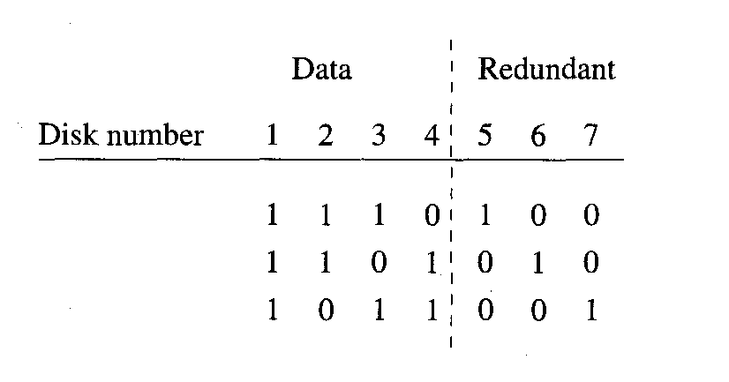
Redundancy pattern for a system that can recover from two simultaneous disk crashes

Slide 139
Coping With Multiple Disk Crashes
The meaning of each of the three rows of U’s and l’s is that if we look at the corresponding hits from all seven disks, and restrict our attention to those disks that have 1 in that row, then the modulo-2 sum of these hits must be U. Put another way, the disks with 1 in a given row of the matrix are treated as if they were the entire set of disks in a RAID level 4 scheme. Thus, we can compute the bits of one of the redundant disks by finding the row in which that disk has 1, and taking the modulo-2 sum of the corresponding bits of the other disks that have 1 in the same row.

Slide 140
Coping With Multiple Disk Crashes
For the matrix, this rule implies:
The bits of disk 5 are the modnlo-2 sum of the corresponding bits of disks 1, 2, and 3.
The bits of disk 6 are the modulo-2 sum of the corresponding bits of disks 1, 2, and 4.
The bits of disk 7 are the modulo-2 sum of the corresponding bits of disks 1, 3, and 4.
We shall see shortly that the particular choice of bits in this matrix gives us a simple rule by which we can recover from two simultaneous disk crashes.

Slide 141
Reading & Writing
Reading
We may read data from any data disk normally. The redundant disks can be ignored.
Writing
The idea is similar to the writing strategy outlined before, but now several redundant disks may be involved. To write a block of some data disk, we compute the modulo-2 sum of the new and old versions of that block. These bits are then added, in a modulo-2 sum, to the corresponding blocks of all those redundant disks that have 1 in a row in which the written disk also has 1.

Slide 142
Example
Let us again assume that blocks are only eight bits long, and focus on the first blocks of the seven disks involved in our RAID level 6 example. First, suppose the data and redundant first blocks are as given. Notice that the block for disk 5 is the modulo-2 sum of the blocks for the first three disks, the sixth row is the modulo-2 sum of rows 1, 2, and 4, and the last row is the modulo-2 sum of rows 1, 3, and 4.
Suppose we rewrite the first block of disk 2 to be 00001111. If we sum this sequence of bits modulo-2 with the sequence 10101010 that is the old value of this block, we get 10100101. If we look at the column for disk 2 in next figure, we find that this disk has l’s in the first two rows, but not the third. Since redundant disks 5 and 6 have 1 in rows 1 and 2, respectively, we must perform the sum modulo-2 operation on the current contents of their first blocks and the sequence 10100101 just calculated. That is, we flip the values of positions 1, 3, 6, and 8 of these two blocks. The resulting contents of the first blocks of all disks is shown in next figure. Notice that the new contents continue to satisfy the constraints implied by previous figure: the modulo-2 sum of corresponding blocks that have 1 in a particular row of the matrix is still all 0’s.

Slide 143
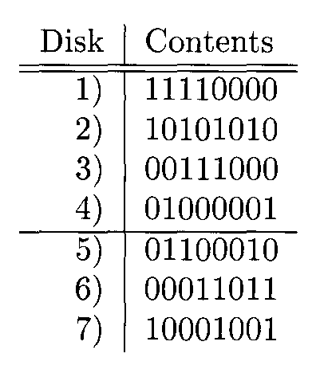
First blocks of all disks

Slide 144
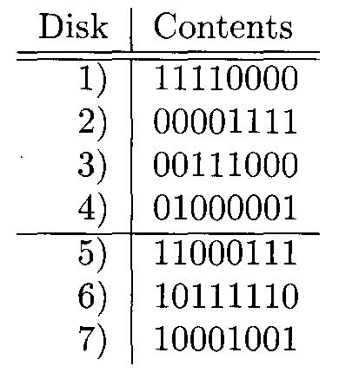
First redundant disks blocks of all disks after rewriting disk 2 and changing the redundant disks

Slide 145
Failure Recovery
Now, let us see how the redundancy scheme outlined above can be used to correct up to two simultaneous disk crashes. Let the failed disks be a and b. Since all columns of the matrix are different, we must be able to find some row r in which the columns for a and b are different. Suppose that a has 0 in row r, while b has 1 there.
Then we can compute the correct b by taking the modulo-2 sum of corresponding bits from all the disks other than b that have 1 in row r. Note that a is not among these, so none of them have failed. Having done so, we must recompute a, with all other disks available. Since every column of the matrix has a 1 in some row, we can use this row to recompute disk a by taking the modulo-2 sum of bits of those other disks with a 1 in this row.

Slide 146
Example
Suppose that disks 2 and 5 fail at about the same time. Consulting the matrix, we find that the columns for these two disks differ in row 2, where disk 2 has 1 but disk 5 has 0. We may thus reconstruct disk 2 by taking the modulo-2 sum of corresponding bits of disks 1, 4, and 6, the other three disks with 1 in row 2. Notice that none of these three disks has failed. For instance, following from the situation regarding the first blocks, we would initially have the data of next figure available after disks 2 and 5 failed.
If we take the modulo-2 sum of the contents of the blocks of disks 1, 4, and 6, we find that the block for disk 2 is 00001111. This block is correct as can be verified from next figure. The situation is now as in last figure.
Now, we see that disk 5’s column has a 1 in the first row. We can therefore recompute disk 5 by taking the modulo-2 sum of corresponding bits from disks 1, 2, and 3, the other three disks that have 1 in the first row. For block 1, this sum is 11000111. Again, the correctness of this calculation can be confirmed by last.

Slide 147
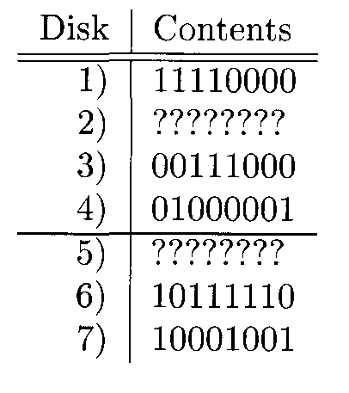
Situation after disks 2 and 5 fail

Slide 148
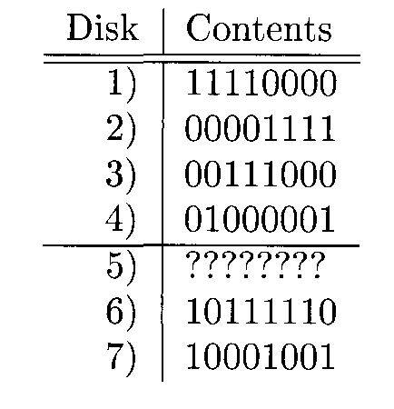
After recovering disk 2

Slide 149
Additional Observations About RAID Level 6
We can combine the ideas of RAID levels 5 and 6, by varying the redundant disks according to the block or cylinder number. Doing so will avoid bottlenecks when writing; the scheme described will cause bottlenecks at the redundant disks.
The scheme described is not restricted to four data disks. The number of disks can be one less than any power of 2, say 2^{k} - 1. Of these disks, k are redundant, and the remaining 2^{k} - k - 1 are data disks, so the redundancy grows roughly as the logarithm of the number of data disks. For any k, we can construct the matrix by writing all possible columns of k 0’s and l’s, except the all-0’s column. The columns with a single 1 correspond to the redundant disks, and the columns with more than one 1 are the data disks.

Slide 150
Error-Correcting Codes and RAID Level 6
There is a theory that guides our selection of a suitable matrix to determine the content of redundant disks. A code of length n is a set of bit-vectors (called code words) of length n. The Hamming distance between two code words is the number of positions in which they differ, and the minimum distance of a code is the smallest Hamming distance of any two different code words.
If C is any code of length n, we can require that the corresponding bits on n disks have one of the sequences that are members of the code. As a very simple example, if we are using a disk and its mirror, then n = 2, and we can use the code C = {00, 11}. That is, the corresponding bits of the two disks must be the same. For another example, the matrix defines the code consisting of the 16 bit-vectors of length 7 that have arbitrary values for the first four bits and have the remaining three bits determined by the rules for the three redundant disks.
If the minimum distance of a code is d, then disks whose corresponding bits are required to be a vector in the code will be able to tolerate d - 1 simultaneous disk crashes. The reason is that, should we obscure d - 1 positions of a code word, and there were two different ways these positions could be filled in to make a code word, then the two code words would have to differ in at most the d - 1 positions. Thus, the code could not have minimum distance d. As an example, the matrix actually defines the well-known Hamming code, which has minimum distance 3. Thus, it can handle two disk crashes.

Slide 151
Summary
Memory Hierarchy: A computer system uses storage components ranging over many orders of magnitude in speed, capacity, and cost per bit. From the smallest/most expensive to largest/cheapest, they are: cache, main memory, secondary memory (disk), and tertiary memory.
Tertiary Storage: The principal devices for tertiary storage are tape cassettes, tape silos (mechanical devices for managing tape cassettes), and “juke boxes” (mechanical devices for managing CD-ROM disks). These storage devices have capacities of many terabytes, but are the slowest available storage devices.
Disks/Secondary Storage: Secondary storage devices are principally magnetic disks with multigigabyte capacities. Disk units have several circular platters of magnetic material, with concentric tracks to store bits. Platters rotate around a central spindle. The tracks at a given radius from the center of a platter form a cylinder.

Slide 152
Summary
Blocks and Sectors: Tracks are divided into sectors, which are separated by unmagnetized gaps. Sectors are the unit of reading and writing from the disk. Blocks are logical units of storage used by an application such as a DBMS. Blocks typically consist of several sectors.
Disk Controller: The disk controller is a processor that controls one or more disk units. It is responsible for moving the disk heads to the proper cylinder to read or write a requested track. It also may schedule competing requests for disk access and buffers the blocks to be read or written.
Disk Access Time: The latency of a disk is the time between a request to read or write a block, and the time the access is completed. Latency is caused principally by three factors: the seek time to move the heads to the proper cylinder, the rotational latency during which the desired block rotates under the head, and the transfer time, while the block moves under the head and is read or written.

Slide 153
Summary
Moore’s Law: A consistent trend sees parameters such as processor speed and capacities of disk and main memory doubling every 18 months. However, disk access times shrink little if at all in a similar period. An important consequence is that the (relative) cost of accessing disk appears to grow as the years progress.
Algorithms Using Secondary Storage: When the data is so large it does not fit in main memory, the algorithms used to manipulate the data must take into account the fact that reading and writing disk blocks between disk and memory often takes much longer than it does to process the data once it is in main memory. The evaluation of algorithms for data in secondary storage thus focuses on the number of disk I/O’s required.
Two-Phase, Multiway Merge-Sort: This algorithm for sorting is capable of sorting enormous amounts of data on disk using only two disk reads and two disk writes of each datum. It is the sorting method of choice in most database applications.

Slide 154
Summary
Speeding Up Disk Access: There are several techniques for accessing disk blocks faster for some applications. They include dividing the data among several disks (to allow parallel access), mirroring disks (maintaining several copies of the data, also to allow parallel access), organizing data that will be accessed together by tracks or cylinders, and prefetching or double buffering by reading or writing entire tracks or cylinders together.
Elevator Algorithm: We can also speed accesses by queueing access requests and handling them in an order that allows the heads to make one sweep across the disk. The heads stop to handle a request each time it reaches a cylinder containing one or more blocks with pending access requests.
Disk Failure Modes: To avoid loss of data, systems must be able to handle errors. The principal types of disk failure are intermittent (a read or write error that will not reoccur if repeated), permanent (data on the disk is corrupted and cannot be properly read), and the disk crash, where the entire disk becomes unreadable.

Slide 155
Summary
Checksums: By adding a parity check (extra bit to make the number of l’s in a bit string even), intermittent failures and permanent failures can be detected, although not corrected.
Stable Storage: By making two copies of all data and being careful about the order in which those copies are written, a single disk can be used to protect against almost all permanent failures of a single sector.
RAID: There are several schemes for using an extra disk or disks to enable data to survive a disk crash. RAID level 1 is mirroring of disks; level 4 adds a disk whose contents are a parity check on corresponding bits of all other disks, level 5 varies the disk holding the parity bit to avoid making the parity disk a writing bottleneck. Level 6 involves the use of error- correcting codes and may allow survival after several simultaneous disk crashes.

